Slide 2
Objectives
Identify the following:
  Conditions that affect the growth of foodborne bacteria (FAT TOM)
  Major foodborne pathogens and their sources; resulting illnesses and their symptoms
  Ways of preventing viral, bacterial, parasitic, and fungal contamination
  Naturally occurring toxins and ways of preventing illnesses caused by them
2-2

Slide 3
Pathogens
  Microorganism:
  Small, living organism that can be seen only with a microscope
  Pathogen:
  Harmful microorganism
  Makes people sick when eaten or produces toxins that cause illness
  Toxin:
  Poison
2-3
Notes:
Instructor Notes
Biological contamination occurs when harmful microorganisms, referred to as pathogens, contaminate food.

Slide 4
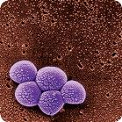
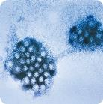
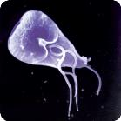
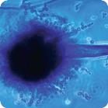
Pathogens
Four types of pathogens can contaminate food and cause foodborne illness:
Bacteria
Viruses
Parasites
Fungi
2-4
Notes:
Instructor Notes
Many viruses, bacteria, and parasites can cause an illness but cannot be seen, smelled, or tasted. On the other hand, some fungi, such as mold, can change the look, smell, or taste of food but may not make people sick.

Slide 5
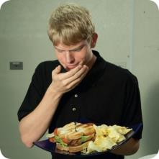
How Contamination Happens
Food handlers can contaminate food when:
  They don’t wash their hands after using
  the restroom.
  They are in contact with a person who is sick.
  They sneeze or vomit onto food or food-contact surfaces.
  They touch dirty food-contact surfaces and equipment and then touch food.
2-5
Notes:
Instructor Notes
Most pathogens get into food and onto food-contact surfaces because of the way that people handle them.
For example, food handlers who don’t wash their hands after using the restroom may contaminate food and surfaces with feces from their fingers. Once the food that the food handler touched is eaten, a foodborne illness may result. This is called the fecal-oral route of contamination.

Slide 6
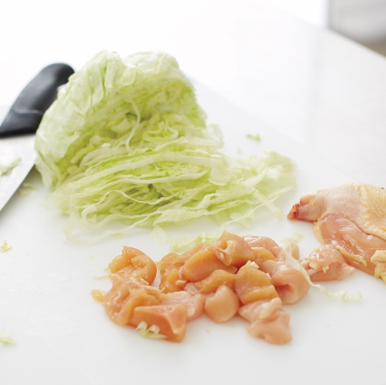
How Contamination Happens
Simple mistakes can cause contamination:
  Allowing ready-to-eat food to touch a surface that contacted raw meat, seafood, or poultry
  Storing food or cleaning products incorrectly
  Failing to spot signs of pests
2-6
Notes:
Instructor Notes
Failure to spot signs of pests in the operation, because pests are a major source of disease.

Slide 7
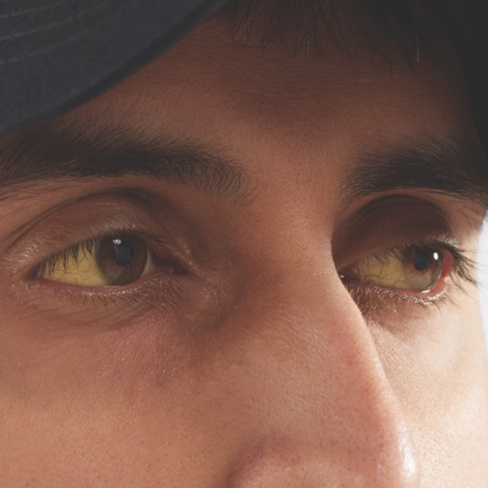
Symptoms of a Foodborne Illness
  Common symptoms of foodborne illness:
  Diarrhea
  Vomiting
  Fever
  Nausea
  Abdominal cramps
  Jaundice—a yellowing of the skin and eyes
  Onset times:
  Depend on the type of foodborne illness
  Can range from 30 minutes to six weeks
2-7
Notes:
Instructor Notes
The symptoms of a foodborne illness vary depending on which illness a person has. But most victims of foodborne illness share some common symptoms.
Not every person who is sick from a foodborne illness will have all of these symptoms. Nor are the symptoms of a foodborne illness limited to this list.
How quickly foodborne-illness symptoms appear in a person is known as the onset time of the illness. Onset times depend on the type of foodborne illness a person has. They can range from 30 minutes to as long as six weeks. How severe the illness is can also vary, from mild diarrhea to death.

Slide 8
The Big Six Pathogens
These pathogens are highly infectious and can cause severe illness:
  Salmonella Typhi
  Shigella spp.
  Nontyphoidal Salmonella (NTS)
  Shiga toxin-producing Escherichia coli (STEC), also knows as E.coli
  Hepatitis A
  Norovirus
2-8
Notes:
Instructor Notes
According to the Food and Drug Administration (FDA), there are over 40 kinds of bacteria, viruses, parasites, and molds that can occur in food and cause a foodborne illness.
Six of these have been singled out by the FDA because they are highly contagious and can cause severe illness. These have been dubbed the Big Six.

Slide 9
The Big Six Pathogens
  The “Big Six” Pathogens:
  Are often found in very high numbers in an infected person’s feces
  Can be transferred to food easily
  Can make a person severely sick from small doses
2-9
Notes:
Instructor Notes
These pathogens are often found in very high numbers in an infected person’s feces and can be transferred to food easily. A person does not have to eat much of the pathogen in order to get sick, and that illness is often severe.
For this reason, food handlers diagnosed with illnesses from these pathogens cannot work in a restaurant or foodservice operation while they are sick.

Slide 10
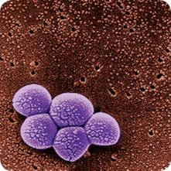
General Information about Bacteria
Shared characteristics of bacteria:
  Found almost everywhere
  Cannot be seen, smelled, or tasted
  Grow rapidly if conditions are correct
  Can produce toxins as they grow and die
  To prevent foodborne illness from bacteria:
  Control time and temperature
2-10
Notes:
Instructor Notes
Bacteria are single-celled, living microorganisms that can spoil food and cause foodborne illness. Bacteria share some basic characteristics.
Some bacteria produce toxins in food as they grow and die. People who eat the toxins can get sick. Cooking may not destroy these toxins.
The most important way to prevent bacteria from causing a foodborne illness is to control time and temperature.

Slide 11

What Bacteria Need to Grow
F
Food
A
Acidity
T
Temperature
T
Time
O
Oxygen
M
Moisture
2-11
Notes:
Instructor Notes
Bacteria need six conditions to grow. You can remember these conditions by thinking of the words FAT TOM.

Slide 12
What Bacteria Need to Grow
Food:
  Most bacteria need nutrients to survive.
  TCS food supports the growth of bacteria better than other types of food.
F
Food
2-12
Notes:
Instructor Notes
Most bacteria need nutrients such as carbohydrates or proteins to survive.
TCS food supports the growth of bacteria better than other types of food. This includes meat, poultry, dairy products, and eggs.

Slide 13
What Bacteria Need to Grow
Acidity:
  Bacteria grow best in food that
  contains little or no acid.
  pH of 7.5 to 4.6 is ideal.
Examples of food with an ideal pH:
  Bread
  Raw chicken
  Cantaloupe
  Milk
  Cooked corn
A
Acidity
2-13
Notes:
Instructor Notes
pH is the measure of acidity. The pH scale ranges from 0 to 14.0. A value of 0 is highly acidic, while a value of 14 is highly alkaline. A pH of 7 is neutral.
Bacteria grow best in food that is neutral to slightly acidic.
Lemons, limes, tomatoes, and mayonnaise are examples of acidic food.
Bread, raw chicken, cantaloupe, milk and cooked corn are examples of food that have an ideal pH for bacterial growth.

Slide 14
What Bacteria Need to Grow
Temperature:
  Bacteria grow rapidly between 41˚F and 135˚F (5˚C and 57˚C).
    This range is known as the
    temperature danger zone .
    Bacteria grow even more rapidly from 70˚F to 125˚F (21˚C to 52˚C).
  Bacteria growth is limited when food is held above or below the temperature danger zone.
T
Temperature
2-14

Slide 15
What Bacteria Need to Grow
Time:
  Bacteria need time to grow.
  The more time bacteria spend in
  the temperature danger zone,
  the more opportunity they have to
  grow to unsafe levels.
T
Time
2-15

Slide 16
What Bacteria Need to Grow
Oxygen:
  Some bacteria need oxygen to grow.
  Other bacteria grow when oxygen isn’t there.
O
Oxygen
2-16
Notes:
Instructor Notes
Bacteria that grow without oxygen can occur in cooked rice, untreated garlic-and-oil mixtures, and temperature-abused baked potatoes.

Slide 17
What Bacteria Need to Grow
Moisture:
  Bacteria grow well in food with high levels
  of moisture.
  aw = water activity.
    The amount of moisture available in food for bacterial growth.
  aw scale ranges from 0.0 to 1.0.
  Water has a water activity of 1.0.
M
Moisture
2-17
Notes:
Instructor Notes
The amount of moisture available in food is called water activity (a_{w}). The a_{w} scale ranges from 0.0 to 1.0.
The higher the value, the more available moisture in the food. For example, water has a water activity of 1.0.
Food with a water activity of 0.85 or higher is ideal for the growth of bacteria.

Slide 18
Controlling FAT TOM Conditions
The conditions you can control:
  Time
    Limit how long TCS food spends in the temperature danger zone.
  Temperature
    Keep TCS food out of the temperature danger zone.
2-18
Notes:
Instructor Notes
You can help keep food safe by controlling FAT TOM. In your operation, however, you will most likely be able to control only time and temperature.

Slide 19
Bacterial Growth
Stages of growth:
2-19
Notes:
Instructor Notes
Bacterial growth can be broken into four progressive stages (phases): lag, log, stationary, and death.
Lag phase: Bacteria that are introduced to food go through an adjustment period called the lag phase. Their number is stable as they get ready to grow. To prevent food from becoming unsafe, prolong the lag phase by controlling the conditions for growth: temperature, time, oxygen, moisture, and pH. As mentioned earlier, you have the most control over time and temperature. For example, refrigerating food keeps bacteria in the lag phase.
Log phase: Bacteria reproduce by splitting in two. Under the correct conditions, they can double as often as every 20 minutes. As a result, food will quickly become unsafe.
Stationary phase: Bacteria can continue to grow until conditions become unfavorable. Eventually they grow and die at the same rate.
Death phase: When dying bacteria outnumber growing bacteria, the population declines.

Slide 20
Bacterial Growth
Stages of growth:
2-20
Notes:
Instructor Notes
The time required for bacteria to enter a lag phase and grow in a log phase depends on FAT TOM conditions. The graph shows how different temperatures affect the growth of Salmonella spp.
Salmonella spp. grows more quickly at warmer temperatures (95°F–99°F [35°C–37°C]) than at colder ones (44°F–50°F [7°C–10°C]). At even colder temperatures (42°F [6°C] and lower), it does not grow at all. But it does not die either, prolonging the lag phase. This is why refrigerating food correctly helps to keep it safe.

Slide 21
Spores
Bacteria can change into spores.
Spores:
  Are often found in dirt
  Can survive cooking temperatures
  Can change back to a form that grows
2-21
Notes:
Instructor Notes
To keep from dying when they lack nutrients, certain bacteria can change into a form called a spore.
Spores are often found in dirt. They can contaminate food grown there, such as potatoes, other vegetables, and rice. They can also contaminate meat, poultry, fish, and other food exposed to dirt or dust.
Spores can resist heat and survive cooking temperatures.
They can also change back into a form that grows. You can prevent this by storing food at the correct temperature. You also need to hold and cool food correctly.

Slide 22
Major Foodborne Bacteria
Bacteria:
  Bacillus cereus
  Listeria monocytogenes
  Shiga toxin-producing E. coli
  Campylobacter jejuni
  Clostridium perfringens
  Clostridium botulinum
  Nontyphoidal Salmonella
  Salmonella Typhi
  Shigella spp.
  Staphylococcus aureus
  Vibrio vulnificus
  Vibrio parahaemolyticus
2-22
Notes:
Instructor Notes
Several different types of bacteria can cause foodborne illness. This slide identifies the major foodborne bacteria.
For each type of bacteria, you should understand the common source and food commonly linked with it. You should also be able to identify the most common symptoms associated with the illness caused by the bacteria. Finally, you should be able to determine the most important prevention measures.

Slide 23
Major Foodborne Bacteria
Controlling time and temperature can keep these bacteria from causing a foodborne illness:
  Bacillus cereus
  Listeria monocytogenes
  Shiga toxin-producing E. coli
  Campylobacter jejuni
  Clostridium perfringens
  Clostridium botulinum
2-23
Notes:
Instructor Notes
The most important prevention measure for the bacteria listed on this slide is controlling time and temperature.
For each type of bacteria, you should understand the common source and food commonly linked with it. You should also be able to identify the most common symptoms associated with the illness caused by the bacteria. Finally, you should be able to determine the most important prevention measures.

Slide 24
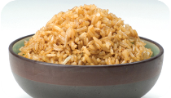
Bacillus cereus
Bacteria: Bacillus cereus (Diarrhea Illness)
Illness: Bacillus cereus gastroenteritis
Commonly Linked Food | Most Common Symptoms
Cooked vegetables Meat products Milk | Watery diarrhea No vomiting
2-24
Notes:
Instructor Notes
The bacteria is pronounced: ba-CIL-us SEER-ee-us.
The illness is pronounced: ba-CIL-us SEER-ee-us GAS-tro-EN-ter-I-tiss.
Bacillus cereus is a spore-forming bacteria found in dirt.
The bacteria can produce two different toxins when allowed to grow to high levels. Each causes a different type of illness. The diarrheal toxin is covered in this slide.

Slide 25
Bacillus cereus
Bacteria: Bacillus cereus (Vomiting Illness)
Illness: Bacillus cereus gastroenteritis
Commonly Linked Food | Most Common Symptoms
Cooked rice dishes including: Fried rice Rice pudding | Nausea Vomiting
2-25

Slide 26
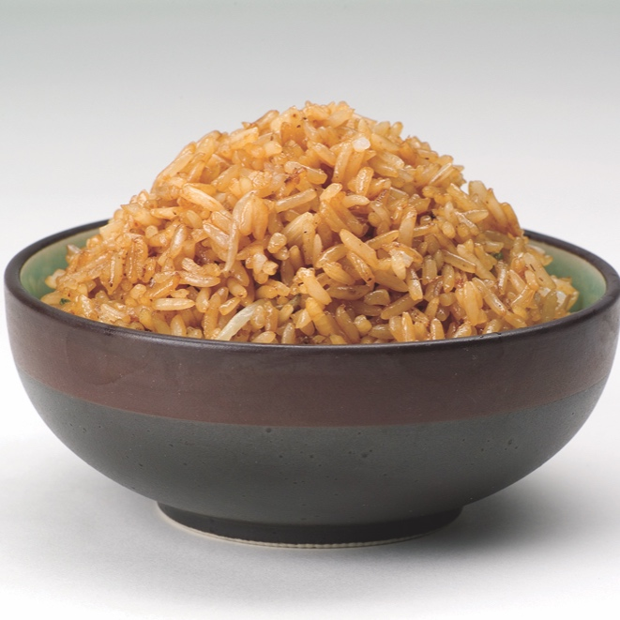
Bacillus cereus
Most important prevention measure:
  Control time and temperature
Other prevention measures:
  Cook food to minimum internal temperatures
  Hold food at the correct temperatures
  Cool food correctly
2-26

Slide 27
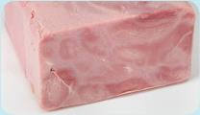
Listeria monocytogenes
Bacteria: Listeria monocytogenes
Illness: Listeriosis
Commonly Linked Food | Most Common Symptoms
Raw meat Ready-to-eat food such as: Deli-meat Hot dogs Soft cheese Unpasteurized dairy products | Pregnant women: Miscarriage Newborns: Sepsis Pneumonia Meningitis
2-27
Notes:
Instructor Notes
The bacteria is pronounced: (liss-TEER-ee-uh MON-o-SI-TAHJ-uh-neez).
The illness is pronounced: liss-TEER-ee-O-sis.
Listeria monocytogenes is found in dirt, water, and plants. Unlike other bacteria, it grows in cool, moist environments. The illness is uncommon in healthy people, but high-risk populations are especially vulnerable as are pregnant women.

Slide 28
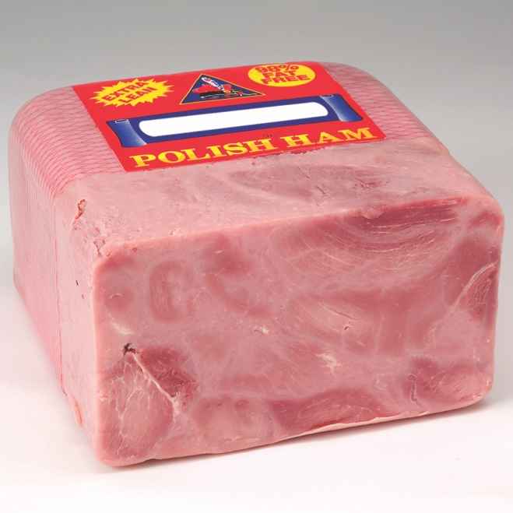
Listeria monocytogenes
Most important prevention measure:
  Control time and temperature.
Other prevention measures:
  Throw out any product that has passed its use-by or expiration date.
  Cook raw meat to minimum internal temperatures.
  Prevent cross-contamination between raw or undercooked food and ready-to-eat food.
  Avoid using unpasteurized dairy products.
2-28

Slide 29
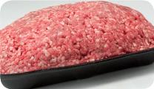
Shiga toxin-producing E. coli
Bacteria: Shiga toxin-producing Escherichia coli, also known as E. coli, including: O157:H7, O26:H11, O111:H8, and O158:NM
Illness: Hemorrhagic colitis
Commonly Linked Food | Most Common Symptoms
Ground beef (raw and undercooked) Contaminated produce | Diarrhea (becomes bloody) Abdominal cramps Kidney failure (in severe cases)
2-29
Notes:
Instructor Notes
The bacteria is pronounced: ess-chur-EE-kee-UH KO-LI.
The illness is pronounced: hem-or-RA-jik ko-LI-tiss.
Shiga toxin-producing E. coli can be found in the intestines of cattle. It is also found in infected people. The bacteria can contaminate meat during slaughtering. Eating only a small amount of the bacteria can make a person sick. Once eaten, it produces toxins in the intestines, which cause the illness. The bacteria are often in a person’s feces for weeks after symptoms have ended.

Slide 30
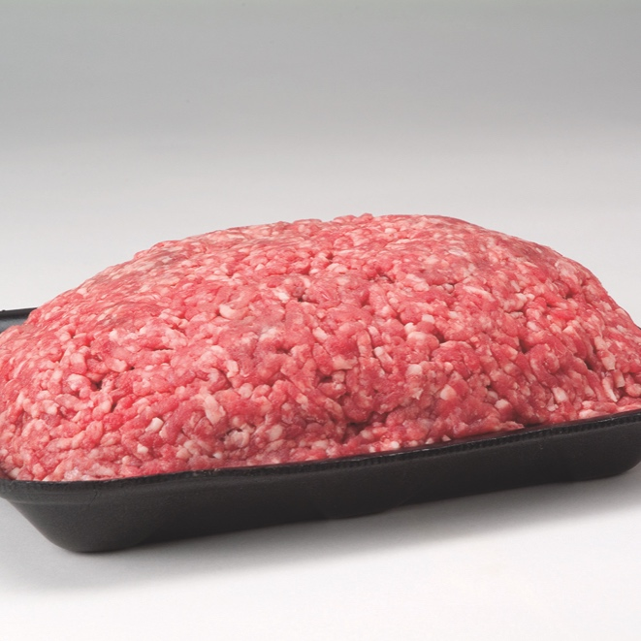
Shiga toxin-producing E. coli
Most important prevention measure:
  Control time and temperature.
Other prevention measures:
  Cook food, especially ground beef, to minimum internal temperatures.
  Purchase produce from approved, reputable suppliers.
  Prevent cross-contamination between raw meat and ready-to-eat food.
  Keep staff with diarrhea who have been diagnosed with hemorrhagic colitis out of the operation.
2-30

Slide 31
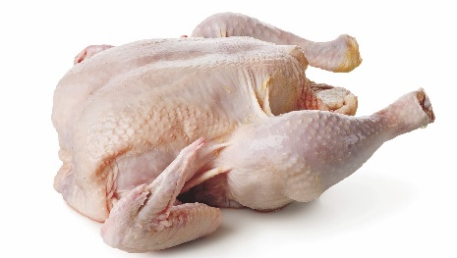
Campylobacter jejuni
        Bacteria: Campylobacter jejuni
        Illness: Campylobacteriosis
Commonly Linked Food | Most Common Symptoms
Poultry Water contaminated with the bacteria Meat Stews/gravies | Diarrhea (may be watery or bloody) Abdominal cramps Fever Vomiting Headaches
2-31
Notes:
Instructor Notes
The bacteria is pronounced: Camp-ee-lo-BAK-ter jay-JUNE-ee.
The illness is pronounced: CAMP-ee-lo-BAK-teer-ee-O-sis.
Though Campylobacter jejuni is commonly associated with poultry, it has been known to contaminate water.
Illness often occurs when poultry is incorrectly cooked and when raw poultry has been allowed to cross-contaminate other food and food-contact surfaces.
The pathogen is best controlled through correct cooking and the prevention of cross-contamination.

Slide 32
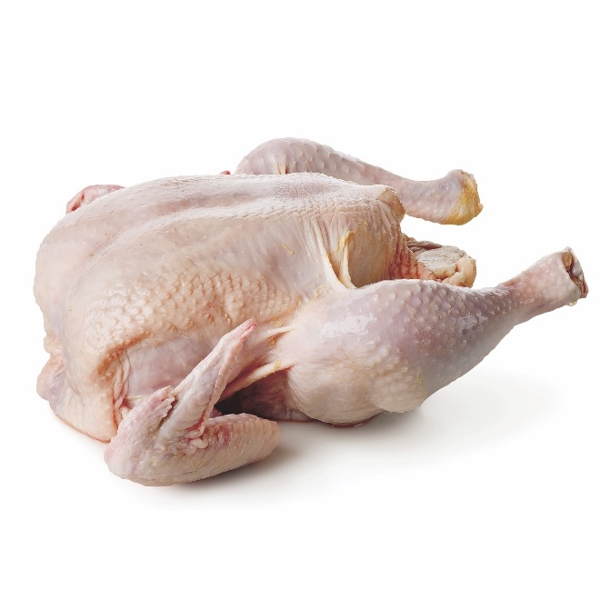
Campylobacter jejuni
Most important prevention measure:
  Control time and temperature.
Other prevention measures:
  Cook food, particularly poultry, to required minimum internal temperatures.
  Prevent cross-contamination between raw poultry and ready-to-eat food.
2-32

Slide 33
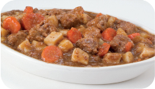
Clostridium perfringens
        Bacteria: Clostridium perfringens
        Illness: Clostridium perfringens gastroenteritis
Commonly Linked Food | Most Common Symptoms
Meat Poultry Dishes made with meat and poultry, such as stews and gravies | Diarrhea Severe abdominal pain
2-33
Notes:
Instructor Notes
The bacteria is pronounced: klos-TRID-ee-um per-FRIN-jins.
The illness is pronounced: klos-TRID-ee-um per-FRIN-jins GAS-tro-EN-ter-I-tiss.
Clostridium perfringens is found in dirt where it forms spores that allow it to survive. It is also carried in the intestines of both animals and humans.
Clostridium perfringens does not grow at refrigeration temperatures. It does grow rapidly in food in the temperature danger zone.
Commercially prepared food is not often involved in outbreaks.
People who get sick usually do not have nausea, fever, or vomiting.

Slide 34
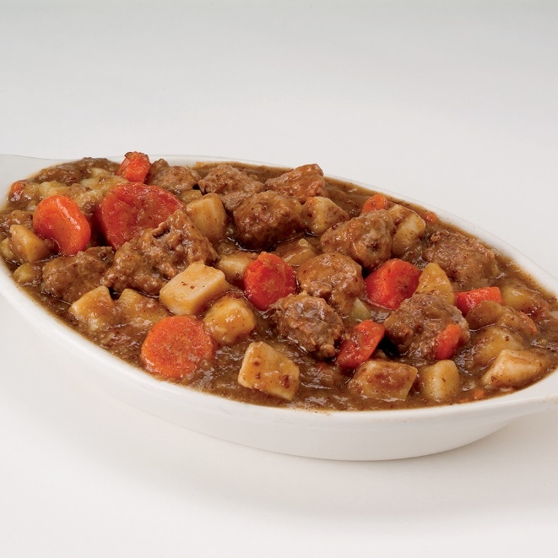
Clostridium perfringens
Most important prevention measure:
  Control time and temperature.
Other prevention measures:
  Cool and reheat food correctly.
  Hold food at the correct temperatures.
2-34

Slide 35
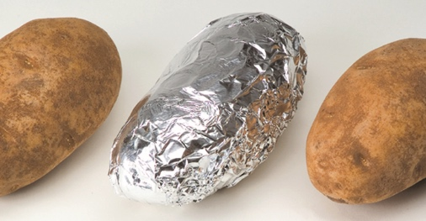
Clostridium botulinum
Bacteria: Clostridium botulinum
Illness: Botulism
Commonly Linked Food | Most Common Symptoms
Incorrectly canned food Reduced-oxygen packaged (ROP) food Temperature-abused vegetables, such as baked potatoes Untreated garlic-and-oil mixtures | Initially: Nausea and vomiting Later: Weakness Double vision Difficulty speaking and swallowing
2-35
Notes:
Instructor Notes
The bacteria is pronounced: klos-TRID-ee-um BOT-chew-LINE-um.
The illness is pronounced: BOT-chew-liz-um.
Clostridium botulinum forms spores that are commonly found in water and dirt. These spores can contaminate almost any food.
The bacteria do not grow well in refrigerated or highly acidic food or in food with low moisture. However, Clostridium botulinum grows without oxygen and can produce a lethal toxin when food is time-temperature abused. Without medical treatment, death is likely.

Slide 36
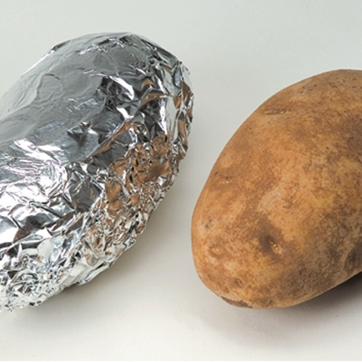
Clostridium botulinum
Most important prevention measure:
  Control time and temperature.
Other prevention measures:
  Hold, cool, and reheat food correctly.
  Inspect canned food for damage.
2-36

Slide 37
Major Foodborne Bacteria
Preventing cross-contamination can keep these bacteria from causing a foodborne illness:
  Nontyphoidal Salmonella
  Salmonella Typhi
2-37
Notes:
Instructor Notes
For each type of bacteria, you must understand the common source, food commonly linked with them, most common symptoms, and most important prevention measures.
Preventing cross-contamination is the most important prevention measure to keep these bacteria from causing a foodborne illness.

Slide 38
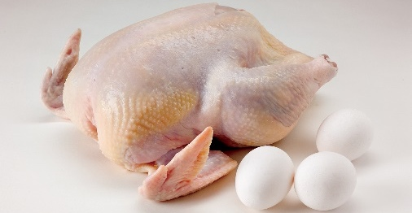
Nontyphoidal Salmonella
Bacteria: Nontyphoidal Salmonella
Illness: Salmonellosis
Commonly Linked Food | Most Common Symptoms
Poultry and eggs Dairy products Produce, such as tomatoes, peppers, and cantaloupes | Diarrhea Abdominal cramps Vomiting Fever
2-38
Notes:
Instructor Notes
The bacteria is pronounced: SAL-me-NEL-uh.
The illness is pronounced: SAL-men-uh-LO-sis.
Many farm animals carry nontyphoidal Salmonella naturally. Eating only a small amount of these bacteria can make a person sick. The severity of symptoms depends on the health of the person and the amount of bacteria eaten. The bacteria are often in a person’s feces for weeks after symptoms have ended.

Slide 39
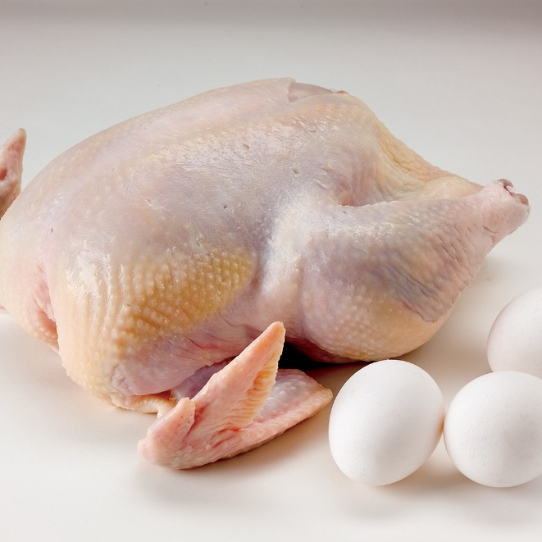
Nontyphoidal Salmonella
Most important prevention measure:
  Prevent cross-contamination.
Other prevention measures:
  Cook poultry and eggs to minimum internal temperatures.
  Prevent cross-contamination between poultry and ready-to-eat food.
  Exclude food handlers who are vomiting or have diarrhea and have been diagnosed with an illness caused by nontyphoidal Salmonella from the operation.
2-39

Slide 40
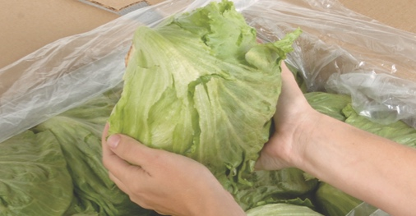
Salmonella Typhi
Bacteria: Salmonella Typhi
Illness: Typhoid Fever
Commonly Linked Food | Most Common Symptoms
Ready-to-eat food Beverages | High fever Weakness Abdominal pain Headache Loss of appetite Rash
2-40
Notes:
Instructor Notes
The bacteria is pronounced: SAL-me-NEL-uh Ti-fee.
Salmonella Typhi lives only in humans.
People with typhoid fever carry the bacteria in their bloodstream and intestinal tract.
Eating only a small amount of these bacteria can make a person sick.
The severity of symptoms depends on the health of the person and the amount of bacteria eaten. The bacteria are often in a person’s feces for weeks after symptoms have ended.

Slide 41
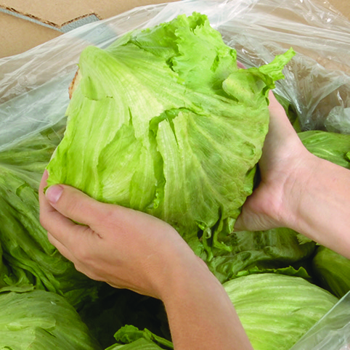
Salmonella Typhi
Most important prevention measure:
  Prevent cross-contamination.
Other prevention measures:
  Exclude food handlers who have been diagnosed with an illness caused by Salmonella Typhi from the operation.
  Wash hands.
  Cook food to minimum internal temperatures.
2-41

Slide 42
Major Foodborne Bacteria
Practicing good personal hygiene can keep these bacteria from causing a foodborne illness:
  Shigella spp.
  Staphylococcus aureus
2-42
Notes:
Instructor Notes
For each type of bacteria, you must understand the common source, food commonly linked with it, most common symptoms, and most important prevention measures.
Practicing good personal hygiene is the most important prevention measure to keep these bacteria from causing a foodborne illness.

Slide 43
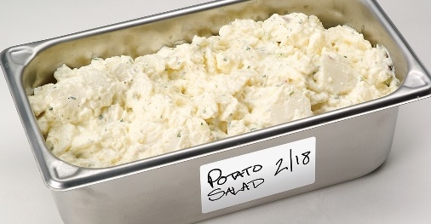
Shigella spp.
Use photo from CB p. 2.14
Bacteria: Shigella spp.
Illness: Shigellosis
Commonly Linked Food | Most Common Symptoms
Food easily contaminated by hands, including: Salads containing TCS food (potato, tuna, shrimp, macaroni, chicken) Food in contact with contaminated water, such as produce | Bloody diarrhea Abdominal pain and cramps Fever (occasionally)
2-43
Notes:
Instructor Notes
The bacteria is pronounced: shi-GEL-uh.
The illness is pronounced: SHIG-uh-LO-sis.
Shigella spp. is found in the feces of humans with the illness. Most illnesses occur when people eat contaminated food or water. Flies can also transfer the bacteria from feces to food. Eating only a small amount of these bacteria can make a person sick. High levels of the bacteria are often in a person’s feces for weeks after symptoms have ended.

Slide 44
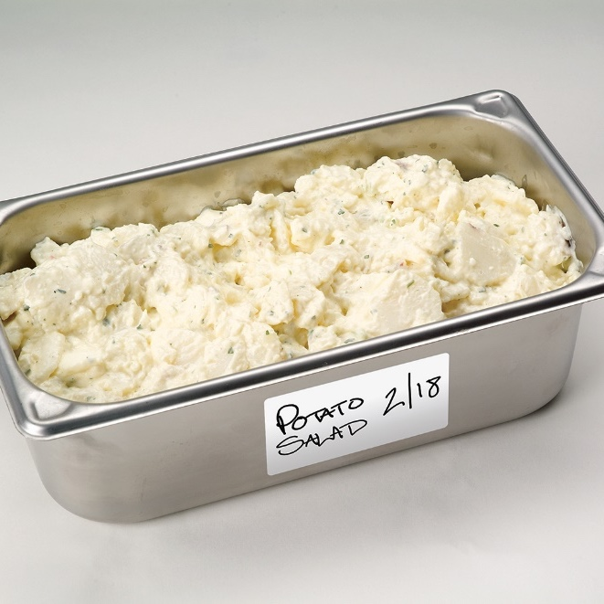
Shigella spp.
Most important prevention measure:
  Practice personal hygiene.
Other prevention measures:
  Exclude food handlers who have diarrhea and have been diagnosed with an illness caused by Shigella spp. from the operation .
  Wash hands.
  Control flies inside and outside the operation.
2-44

Slide 45
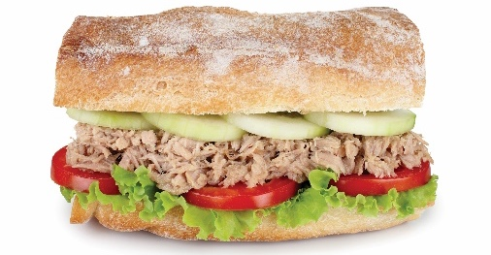
Staphylococcus aureus
Bacteria: Staphylococcus aureus
Illness: Staphylococcal gastroenteritis
Commonly Linked Food | Most Common Symptoms
Food requiring handling during prepping, including: Food that requires handling during prepping Salads containing TCS food (egg, tuna, chicken, macaroni) Deli meat | Nausea Vomiting and retching Abdominal cramps
2-45
Notes:
Instructor Notes
The bacteria is pronounced: STAF-uh-lo-KOK-us OR-ee-us.
The illness is pronounced: STAF-ul-lo-KOK-al GAS-tro-EN-ter-I-tiss.
Staphylococcus aureus can be found in humans—particularly in the hair, nose, throat, and in infected wounds. It is often transferred to food when people carrying it touch these areas on their bodies and then handle food without washing their hands. If allowed to grow to large numbers in food, the bacteria can produce toxins that cause the illness when eaten. Cooking cannot destroy these toxins, so preventing bacterial growth is critical.

Slide 46
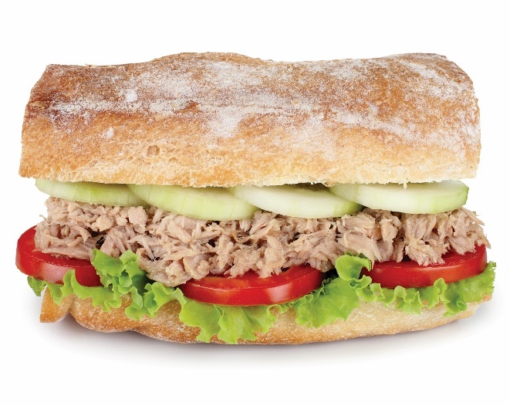
Staphylococcus aureus
Most important prevention measure:
  Practice personal hygiene.
Other prevention measures:
  Wash hands, particularly after touching the hair, face, or body.
  Cover wounds on hands and arms.
  Hold, cool, and reheat food correctly.
2-46

Slide 47
Major Foodborne Bacteria
Purchasing food from approved, reputable suppliers can keep these bacteria from causing a foodborne illness:
  Vibrio vulnificus
  Vibrio parahaemolyticus
2-47
Notes:
Instructor Notes
For these types of bacteria, you must understand the common source, food commonly linked with them, most common symptoms, and most important prevention measures.
Purchasing from approved, reputable suppliers is the most important prevention measure for these bacteria.

Slide 48
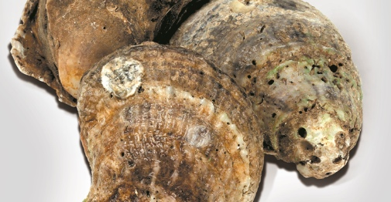
  Vibrio vulnificus & Vibrio parahaemolyticus
Bacteria: Vibrio vulnificus and Vibrio parahaemolyticus
Illness: Vibrio gastroenteritis Vibrio vulnificus primary septicemia
Commonly Linked Food | Most Common Symptoms
Oysters from contaminated water | Diarrhea Abdominal cramps and nausea Vomiting Low-grade fever and chills
2-48
Notes:
Instructor Notes
The bacteria is pronounced: VIB-ree-o vul-NIF-ih-kus.
The illness is pronounced: VIB-ree-o GAS-tro-EN-ter-I-tiss or VIB-ree-o vul-NIF-ih-kus SEP-ti-SEE-mee-uh.
These bacteria are found in the water where shellfish are harvested. They can grow very rapidly at temperatures in the middle of the temperature danger zone. People with chronic conditions (such as diabetes or cirrhosis) who get sick from these bacteria may get primary septicemia. This severe illness can lead to death.

Slide 49
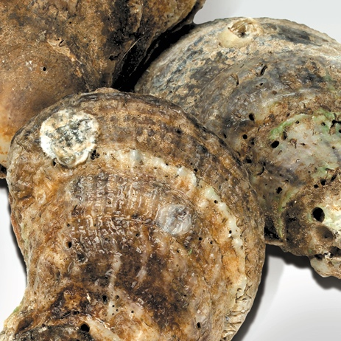
  Vibrio vulnificus & Vibrio parahaemolyticus
Most important prevention measure:
  Purchase from approved, reputable suppliers.
Other prevention measures:
  Cook oysters to minimum internal temperatures.
2-49

Slide 50
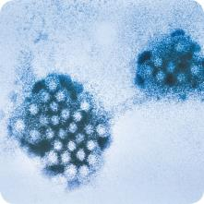
General Information About Viruses
Location:
  Carried by human beings and animals.
    Require a living host to grow.
    Do not grow in food.
    Can be transferred through food and remain infectious in food.
Sources:
  Food, water, or any contaminated surface.
  Typically occur through fecal-oral routes.
2-50
Notes:
Instructor Notes
The virus is the smallest of the microbial food contaminants. Viruses share some basic characteristics.
Norovirus is one of the leading causes of foodborne illness. It is often transmitted through airborne vomit particles.

Slide 51
General Information About Viruses
Transfer:
  Viruses can be transferred from
    Person to person
    People to food
    People to food-contact surfaces
  People
    Carry viruses in their feces
    Can transfer them to their hands after using the restroom
2-51
Notes:
Instructor Notes
When guests get sick from food contaminated with viruses, it is usually because their food was handled by an infected person. That person could be the operation’s food handler, a staff member of the food manufacturer, or anyone else who has the virus.

Slide 52
General Information About Viruses
Viruses cannot be destroyed by normal cooking temperatures.
Prevention measures:
  Exclude food handlers who are vomiting or have diarrhea or jaundice from working.
  Make sure food handlers wash their hands regularly and correctly.
  Avoid bare-hand contact with ready-to-eat food.
2-52
Notes:
Instructor Notes
Viruses are not destroyed by normal cooking temperatures. That is why it is important to practice good personal hygiene when handling food and food-contact surfaces.
The quick removal and cleanup of vomit is also important.

Slide 53
Major Foodborne Viruses
Practicing good personal hygiene can keep these viruses from causing a foodborne illness:
  Hepatitis A
  Norovirus
2-53
Notes:
Instructor Notes
For each type of virus, you must understand the common source, food commonly linked with it, most common symptoms, and most important prevention measures.
Practicing personal hygiene is the most important prevention measure to keep these viruses from causing a foodborne illness.

Slide 54
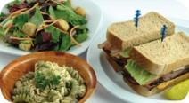
Hepatitis A
Virus: Hepatitis A
Illness: Hepatitis A
Commonly Linked Food | Most Common Symptoms
Ready-to-eat food Shellfish from contaminated water | Fever (mild) General Weakness Nausea Abdominal pain Jaundice (appears later)
2-54
Notes:
Instructor Notes
Hepatitis A is mainly found in the feces of people infected with it. The virus can contaminate water and many types of food. It is commonly linked with ready-to-eat food. However it has also been linked with shellfish from contaminated water.
The virus is often transferred to food when infected food handlers touch food or equipment with fingers that have feces on them.
Eating only a small amount of the virus can make a person sick.
An infected person may not show symptoms for weeks but can be very infectious.
Cooking does not destroy Hepatitis A.

Slide 55
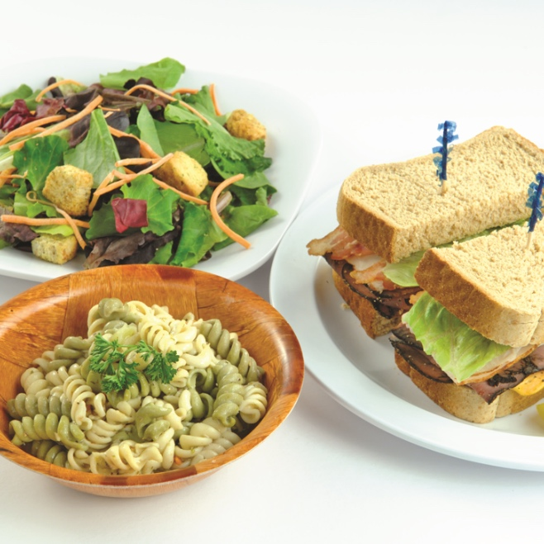
Hepatitis A
Most important prevention measure:
  Practicing good personal hygiene.
Other prevention measures:
  Exclude food handlers who have been diagnosed with Hepatitis A from the operation.
  Exclude food handlers who have had jaundice for seven days or less from the operation.
  Wash hands.
  Avoid bare-hand contact with ready-to-eat food.
  Purchase shellfish from approved, reputable suppliers.
2-55

Slide 56
Norovirus
Virus: Norovirus
Illness: Norovirus gastroenteritis
Commonly Linked Food | Most Common Symptoms
Ready-to-eat food Shellfish from contaminated water | Vomiting Diarrhea Nausea Abdominal cramps
2-56
Notes:
Instructor Notes
Like hepatitis A, Norovirus is commonly linked with ready-to-eat food.
It has also been linked with contaminated water.
Norovirus is often transferred to food when infected food handlers touch food or equipment with fingers that have feces on them.
Eating only a small amount of Norovirus can make a person sick. It is also very contagious.
People become contagious within a few hours after eating it.
The virus is often in a person’s feces for days after symptoms have ended.

Slide 57
Norovirus
Most important prevention measure:
  Practicing good personal hygiene.
Other prevention measures:
  Exclude food handlers who are vomiting or have diarrhea and have been diagnosed with Norovirus from the operation.
  Wash hands.
  Avoid bare-hand contact with ready-to-eat food.
  Purchase shellfish from approved, reputable suppliers.
2-57

Slide 58
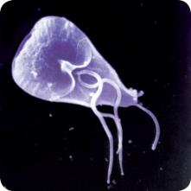
Characteristics of Parasites
Location:
  Require a host to live and reproduce
Source:
  Seafood, wild game, and food processed with contaminated water, such as produce
2-58
Notes:
Instructor Notes
Parasites cannot grow in food. They require a host to live and reproduce.

Slide 59
Characteristics of Parasites
Prevention:
  Purchase food from approved, reputable suppliers.
  Cook food to required minimum internal temperatures.
  Fish that will be served raw or undercooked must be frozen correctly by the manufacturer.
2-59

Slide 60
Major Foodborne Parasites
Purchasing from approved, reputable suppliers can keep these parasites from causing a foodborne illness:
  Anisakis simplex
  Cryptosporidium parvum
  Giardia duodenalis
  Cyclospora cayetanensis
2-60
Notes:
Instructor Notes
For each type of parasite, you must understand the common source, food commonly linked with it, most common symptoms, and most important prevention measures.
Purchasing from approved, reputable suppliers is the most important prevention measure for these parasites.

Slide 61
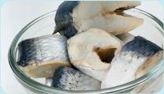
Anisakis simplex
Parasite: Anisakis simplex
Illness: Anisakiasis
Commonly Linked Food | Most Common Symptoms
Raw and undercooked fish, including: Herring Code Halibut Mackerel Pacific Salmon | Tingling in throat Coughing up worms
2-61
Notes:
Instructor Notes
The parasite is pronounced: ANN-ih-SAHK-iss SIM-plex.
The illness is pronounced: ANN-ih-SAH-KYE-ah-sis.
People can get sick when they eat raw or undercooked fish containing this parasite.

Slide 62
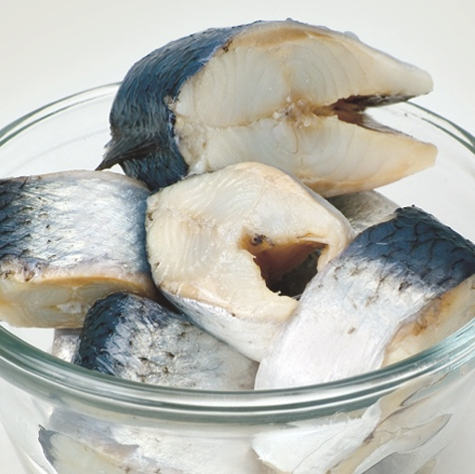
Anisakis simplex
Most important prevention measure:
  Purchase from approved, reputable suppliers.
Other prevention measures:
  Cook fish to minimum internal temperatures.
  If serving raw or undercooked fish, purchase sushi-grade fish that has been frozen to the correct time-temperature requirements.
2-62

Slide 63
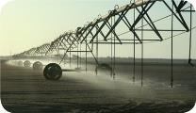
Cryptosporidium parvum
Parasite: Cryptosporidium parvum
Illness: Cryptosporidiosis
Commonly Linked Food | Most Common Symptoms
Contaminated water Produce | Watery diarrhea Abdominal cramps Nausea Weight loss
2-63
Notes:
Instructor Notes
The parasite is pronounced: KRIP-TOH-spor-ID-ee-um PAR-vum.
The illness is pronounced: KRIP-TOH-spor-id-ee-O-sis.
Cryptosporidium parvum can be found in the feces of infected people. Food handlers can transfer it to food when they touch food with fingers that have feces on them. Day-care and medical communities have been frequent locations of person-to-person spread of this parasite. Symptoms will be more severe in people with weakened immune systems.

Slide 64
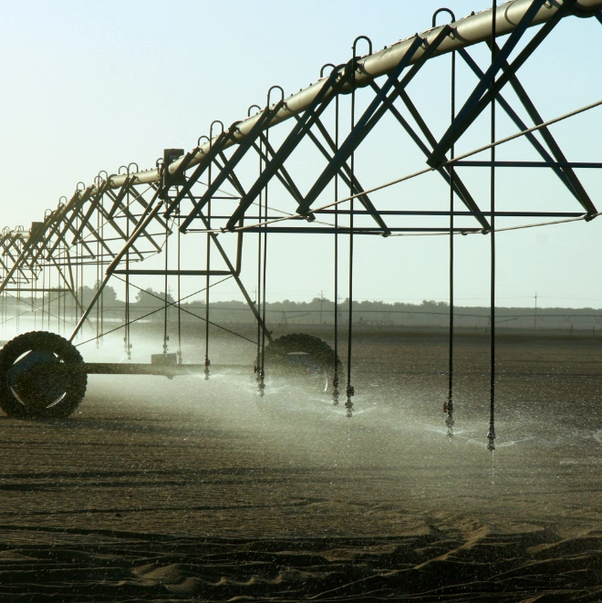
Cryptosporidium parvum
Most important prevention measure:
  Purchase from approved, reputable suppliers.
Other prevention measures:
  Use correctly treated water.
  Keep food handlers with diarrhea out of the operation.
  Wash hands.
2-64

Slide 65
Giardia duodenalis
        Parasite: Giardia duodenalis (G. lamblia or G. Intestinalis)
        Illness: Giardiasis
Commonly Linked Food | Most Common Symptoms
Incorrectly treated water Produce | Initially Fever Later Diarrhea Abdominal cramps Nausea
2-65
Notes:
Instructor Notes
The parasite is pronounced: jee-ARE-dee-uh do-WAH-den-AL-is.
The illness is pronounced: JEE-are-DYE-uh-sis.
Giardia duodenalis can be found in the feces of infected people. Food handlers can transfer the parasite to food when they touch food with fingers that have feces on them.

Slide 66
Giardia duodenalis
Most important prevention measure:
  Purchase from approved, reputable suppliers.
Other prevention measures:
  Use correctly treated water.
  Keep food handlers with diarrhea out of the operation.
  Wash hands.
2-66

Slide 67
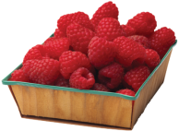
Cyclospora cayetanensis
        Parasite: Cyclospora cayetanensis
        Illness: Cyclosporiasis
Commonly Linked Food | Most Common Symptoms
Incorrectly treated water Produce such as berries, lettuce, or basil | Nausea Abdominal cramps Mild fever Diarrhea alternating with constipation Loss of weight Loss of appetite
2-67
Notes:
Instructor Notes
The parasite is pronounced: SI-klo-spor-uh KI-uh-te-NEN-sis.
The illness is pronounced: SI-klo-spor-I-uh-sis.
Cyclospora cayetanensis is a parasite that has been found in contaminated water and has been associated with produce irrigated or washed with contaminated water. It can also be found in the feces of infected people. Food handlers can transfer the parasite to food when they touch it with fingers containing feces. For this reason, food handlers with diarrhea must be excluded from the operation. It is also critical to purchase produce from approved, reputable suppliers.

Slide 68
Cyclospora cayetanensis
Most important prevention measure:
  Purchase from approved, reputable suppliers.
Other prevention measures:
  Purchase produce from approved, reputable suppliers.
  Keep food handlers with diarrhea out of the operation.
  Wash hands.
2-68

Slide 69
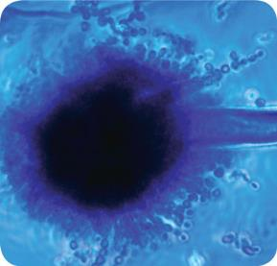
Fungi
Fungi:
  Sometimes make people sick
  Commonly spoil food
  Examples of fungi
    Mold
    Yeast
2-69
Notes:
Instructor Notes
Fungi are pathogens that only sometimes make people sick. Mostly, they spoil food. They are found in air, dirt, plants, water, and some food. Mold and yeast are examples.

Slide 70
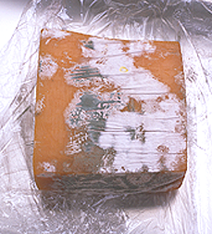
Mold
Basic characteristics of mold:
  Spoil food and sometimes cause illness.
  May produce toxins.
  Grow well in almost any condition, especially in acidic food with low water activity.
  Are only slowed not destroyed by cooler or freezer temperatures.
  Prevention:
  Throw out all moldy food unless the mold is a natural part of the food.
2-70
Notes:
Instructor Notes
Some molds produce toxins, such as aflatoxins.
Molds grow under almost any condition. They grow particularly well in acidic food with low water activity, such as jams, jellies, and cured, salty meat (e.g., ham, bacon, and salami).
Some molds produce toxins that can cause allergic reactions, nervous system disorders, and kidney and liver damage. For example, aflatoxin, produced by the molds Aspergillus flavus and Aspergillus parasiticus, can cause liver disease. Food such as corn and corn products, peanuts and peanut products, cottonseed, milk, and tree nuts (such as Brazil nuts, pecans, pistachio nuts, and walnuts) have been associated with aflatoxins.
Throw out all moldy food unless the mold is a natural part of the product (e.g., cheese such as Brie, Camembert, and Gorgonzola).
The FDA recommends cutting away moldy areas in hard cheese—at least one inch (2.5 centimeters) around them. You can also use this procedure on food such as salami and firm fruits and vegetables.

Slide 71
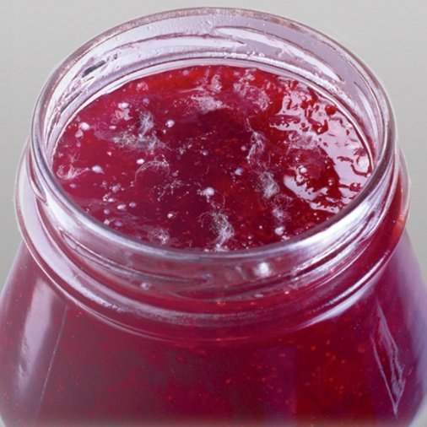
Yeast
Basic characteristics of yeast:
  Can spoil food quickly.
  May produce a smell or taste of
  alcohol as it spoils food.
  May look like a white or pink discoloration or slime and may bubble.
  Grow well in acidic food with little moisture.
  Prevention:
  Throw away food containing yeast.
2-71
Notes:
Instructor Notes
Like molds, yeasts grow well in acidic food with little moisture, such as jellies, jams, syrup, honey, and fruit or fruit juice.

Slide 72
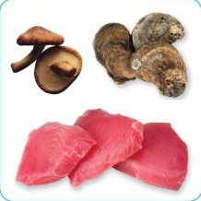
Biological Toxins
Sources of biological toxins:
  Seafood
  Plants
  Mushrooms
2-72
Notes:
Instructor Notes
Some toxins are naturally associated with certain plants, mushrooms, and seafood. Toxins are a natural part of some fish.

Slide 73
Seafood Toxins
Seafood toxins:
  Cannot be smelled or tasted
  Cannot be destroyed by freezing or cooking
  Sources in fish:
    Naturally occurring
    Pathogens
    Fish that have eaten smaller fish that have eaten the toxin
  Sources in shellfish:
    Shellfish that have eaten algae that are toxic
2-73
Notes:
Instructor Notes
Some toxins are naturally associated with certain plants, mushrooms, and seafood. Toxins are a natural part of some fish.
Some fish toxins are a natural part of the fish. These are called systemic toxins. Puffer fish, moray eels, and freshwater minnows all produce them. Because of the extreme risk it poses, puffer fish should not be served unless the chef has been licensed to prepare it.
Other toxins are made by pathogens on the fish. Some fish can also become contaminated when they eat smaller fish that have eaten a toxin.
Shellfish, such as oysters, can be contaminated when they eat marine algae that have a toxin.

Slide 74
Seafood Toxins
Purchasing from approved, reputable suppliers can keep these fish toxins from causing a foodborne illness:
  Histamine
  Ciguatoxin
  Saxitoxin
  Brevetoxin
  Domoic acid
2-74
Notes:
Instructor Notes
For each major seafood toxin, you must understand the common source, food commonly linked with it, most common symptoms, and most important prevention measures.
Purchasing from approved, reputable suppliers is the most important prevention measure for these toxins.

Slide 75
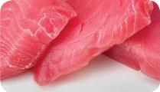
Histamine
Toxin: Histamine
Illness: Scombroid poisoning
Commonly Linked Food | Most Common Symptoms
Tuna Bonito Mackerel Mahimahi | Initially Reddening of the face and neck Sweating Headache Burning or tingling sensation in the mouth or throat Possibly later Diarrhea Vomiting
2-75
Notes:
Instructor Notes
Histamine poisoning can occur when high levels of histamine in scombroid and other species of fish are eaten.
When the fish are time-temperature abused, bacteria on the fish make the toxin. It cannot be destroyed by freezing, cooking, smoking, or curing.

Slide 76
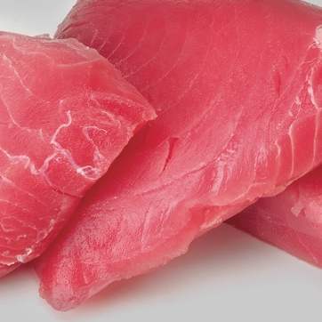
Histamine
Most important prevention measure:
  Purchase from approved, reputable suppliers.
Other prevention measures:
  Prevent time-temperature abuse during storage and preparation.
2-76

Slide 77
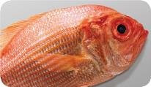
Ciguatoxin
Toxin: Ciguatoxin
Illness: Ciguatera fish poisoning
Commonly Linked Food | Most Common Symptoms
Predatory tropical reef fish from Pacific Ocean, Western Indian Ocean, and Caribbean Sea: Barracuda Grouper Jacks Snapper | Reversal of hot and cold sensations Nausea Vomiting Tingling in fingers, lips, or toes Joint and muscle pain
2-77
Notes:
Instructor Notes
Ciguatoxin is found in some marine algae. The toxin builds up in certain fish when they eat smaller fish that have eaten the toxic algae.
Ciguatoxin cannot be detected by smell or taste. It is not eliminated by cooking or freezing the fish. Symptoms may last months or years depending on how severe the illness is.

Slide 78
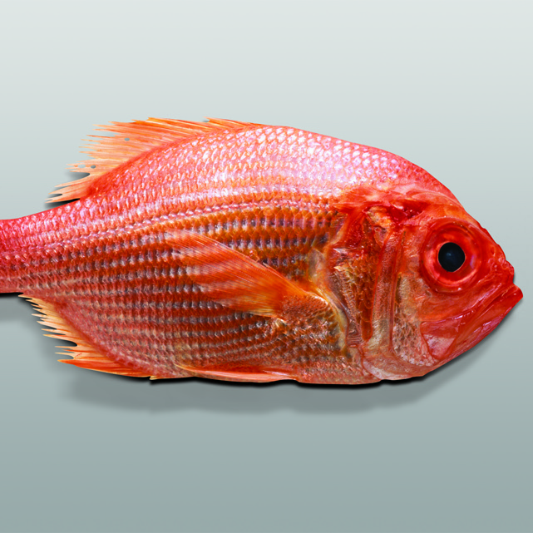
Ciguatoxin
Most important prevention measure:
  Purchase predatory tropical reef fish from approved, reputable suppliers.
2-78

Slide 79
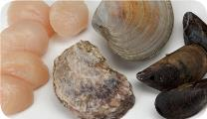
Saxitoxin
Toxin: Saxitoxin
Illness: Paralytic shellfish poisoning (PSP)
Commonly Linked Food | Most Common Symptoms
Shellfish found in colder waters such as those of the Pacific and New England coasts: Clams Oysters Mussels Scallops | Numbness Tingling in mouth, face, arms, and legs Dizziness Nausea Vomiting Diarrhea
2-79
Notes:
Instructor Notes
Some types of shellfish can become contaminated as they filter toxic algae from the water.
People can get sick with paralytic shellfish poisoning (PSP) when they eat these shellfish.
Saxitoxin cannot be smelled or tasted. It is not destroyed by cooking or freezing. Death from paralysis may result if high levels of the toxin are eaten.

Slide 80
Saxitoxin
Most important prevention measure:
  Purchase shellfish from approved, reputable suppliers.
2-80

Slide 81
Brevetoxin
Toxin: Brevetoxin
Illness: Neurotoxic shellfish poisoning (NSP)
Commonly Linked Food | Most Common Symptoms
Shellfish in warmer waters of west coast of Florida, Gulf of Mexico, and Caribbean Sea: Clams Mussels Oysters | Tingling and numbness of the lips, tongue, and throat Dizziness Reversal of hot and cold sensations Vomiting Diarrhea
2-81
Notes:
Instructor Notes
Some types of shellfish can become contaminated as they filter toxic algae from the water.
People can get sick with neurotoxic shellfish poisoning (NSP) when they eat these shellfish.
Brevetoxin cannot be smelled or tasted. It is not destroyed by cooking or freezing.

Slide 82
Brevetoxin
Most important prevention measure:
  Purchase shellfish from approved, reputable suppliers.
2-82

Slide 83
Domoic acid
Toxin: Domoic acid
Illness: Amnesic shellfish poisoning (ASP)
Commonly Linked Food | Most Common Symptoms
Shellfish found in coastal waters of Pacific Northwest and east coast of Canada: Clams Mussels Oysters Scallops | Initially: Vomiting Diarrhea Abdominal pain Possibly later: Confusion Memory loss Disorientation Seizure Coma
2-83
Notes:
Instructor Notes
Some types of shellfish can become contaminated as they filter toxic algae from the water.
People can get sick with amnesic shellfish poisoning (ASP) when they eat these shellfish. The severity of symptoms depends on the amount of toxin eaten and the health of the person.
Domoic acid cannot be smelled or tasted. It is not destroyed by cooking or freezing.

Slide 84
Domoic acid
Most important prevention measure:
  Purchase shellfish from approved, reputable suppliers.
2-84

Slide 85
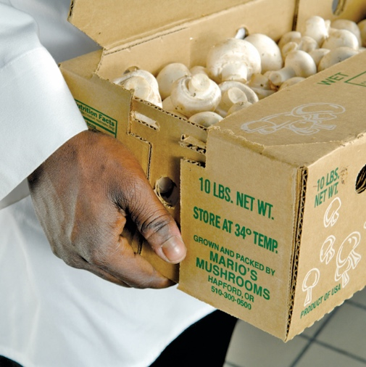
Mushroom Toxins
Foodborne illnesses linked with mushrooms:
  Are caused by eating toxic wild mushrooms
  Occur when toxic mushrooms are mistaken for edible ones
  Can be prevented by purchasing from approved, reputable suppliers
2-85
Notes:
Instructor Notes
Foodborne illnesses linked with mushrooms are almost always caused by eating toxic, wild mushrooms collected by amateur hunters. Most cases happen because toxic mushrooms are mistaken for edible ones.
The symptoms of illness depend on the type of toxic mushrooms eaten.
Mushroom toxins are not destroyed by cooking or freezing.
Do not use mushrooms or mushroom products unless you have purchased them from approved, reputable suppliers.

Slide 86
Plant Toxins
Foodborne illnesses linked with plant toxins:
  Usually happen when plants are purchased from unapproved suppliers
  Can happen when certain plants aren’t cooked correctly (e.g., undercooked kidney beans)
  Can be prevented by purchasing plants from approved, reputable suppliers
2-86
Notes:
Instructor Notes
Here are some examples of items that can make people sick: toxic plants, such as fool’s parsley or wild turnips, mistaken for the edible version; honey from bees allowed to harvest nectar from toxic plants; and undercooked kidney beans.
Purchase plants and items made with plants only from approved, reputable suppliers. Then cook and hold dishes made from these items correctly.

