Slide 1
Welcome

Slide 3
Objectives
Identify the following:
What a foodborne illness is and how to determine when one has occurred
Challenges to food safety
Costs of a foodborne illness
Contaminants that can make food unsafe
1-2

Slide 4
Keeping Food Safe: Objectives
Identify the following:
How food becomes unsafe
Food most likely to become unsafe
Populations at high risk for foodborne illness
Food safety responsibilities of the person in charge of a restaurant or foodservice operation
1-3

Slide 5
Foodborne Illnesses
A foodborne illness is a disease transmitted to people through food.
An illness is considered an outbreak when:
Two or more people have the same symptoms after eating the same food.
An investigation is conducted by state and local regulatory authorities.
The outbreak is confirmed by laboratory analysis.
1-4

Slide 6
Challenges to Food Safety
Challenges include:
Time
Language and culture
Literacy and education
Pathogens
Unapproved suppliers
High-risk customers
Staff turnover
1-5
Notes:
Instructor Notes
Pressure to work quickly can make it hard to take the time to follow food safety practices.
Your staff may speak a different language than you do, which can make it difficult to communicate. Cultural differences can also influence how food handlers view food safety.
Staff often have different levels of education making it more challenging to teach them food safety.
Illness-causing microorganisms are more frequently found on food that once was considered safe.
Food that is received from suppliers who are not practicing food safety can cause a foodborne-illness outbreak.
The number of customers at high risk for getting a foodborne illness is increasing. An example of this is the growing elderly population.
Training new staff leaves less time for food safety training.
The ServSafe program will provide the tools needed to overcome the challenges in managing a good food safety program.

Slide 7
The Costs of Foodborne Illnesses
Costs of a foodborne illness to an operation:
Loss of customers and sales
Loss of reputation
Negative media exposure
Lowered staff morale
1-6
Notes:
Instructor Notes
National Restaurant Association figures show that one foodborne-illness outbreak can cost an operation thousands of dollars and even result in closure.

Slide 8
The Costs of Foodborne Illnesses
Lawsuits and legal fees
Staff missing work
Increased insurance premiums
Staff retraining
1-7
Notes:
Instructor Notes
National Restaurant Association figures show that a foodborne-illness outbreak can cost an operation thousands of dollars.
Most important are the human costs. Victims of foodborne illnesses may experience lost work, medical costs and long-term disability, and death.

Slide 9
How Foodborne Illnesses Occur
Unsafe food is the result of contamination:
Biological
Chemical
Physical
1-8
Notes:
Instructor Notes
Unsafe food is usually the result of contamination, which is the presence of harmful substances in the food.
Contaminants can come from pathogens, chemicals, or physical objects. They might also come from certain unsafe practices in your operation.
Each of the contaminants listed here is a danger to food safety. But biological contaminants are responsible for most foodborne illness.

Slide 10
Contaminants
Biological contaminants:
Bacteria
Viruses
Parasites
Fungi
1-9
Notes:
Instructor Notes
Pathogens are the greatest threat to food safety. They include certain viruses, parasites, fungi, and bacteria. Some plants, mushrooms, and seafood that carry harmful toxins (poisons) are also included in this group.

Slide 11
Contaminants
Chemical contaminants:
Cleaners
Sanitizers
Polishes
1-10
Notes:
Instructor Notes
Foodservice chemicals can contaminate food if they are used incorrectly.

Slide 12
Contaminants
Physical hazards:
Metal shavings
Staples
Bandages
Glass
Dirt
Natural objects (e.g., fish bones in a fillet)
1-11

Slide 13
How Food Becomes Unsafe
Five risk factors for foodborne illness:
Purchasing food from unsafe sources
Failing to cook food correctly
Holding food at incorrect temperatures
Using contaminated equipment
Practicing poor personal hygiene
1-12
Notes:
Instructor Notes
If food is not handled correctly, it can become unsafe. These are the five most common food-handling mistakes, or risk factors, that can cause foodborne illness.
Purchasing food from unsafe sources can be a big problem. So purchasing food from approved, reputable suppliers is critical. This will be discussed in greater detail later.
Keep in mind that food prepared in a private home is also considered to be from an unsafe source and must be avoided.

Slide 14
How Food Becomes Unsafe
Time-temperature abuse
Cross-contamination
Poor personal hygiene
Poor cleaning and sanitizing
1-13
Notes:
Instructor Notes
Except for purchasing food from unsafe sources, each risk factor for foodborne illness is related to four main factors: time-temperature abuse, cross-contamination, poor personal hygiene, and poor cleaning and sanitizing.

Slide 15
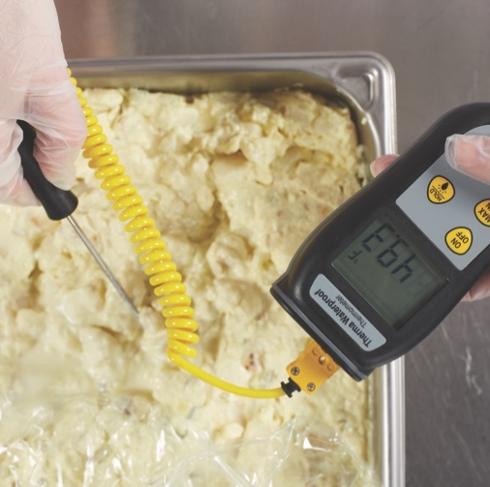
How Food Becomes Unsafe
Time-temperature abuse:
When food has stayed too long at temperatures good for pathogen growth.
1-14

Slide 16
How Food Becomes Unsafe
Food has been time-temperature abused when:
It has not been held or stored at correct temperatures.
It is not cooked or reheated enough to kill pathogens.
It is not cooled correctly.
Pg 1.5 SSF 6e
1-15

Slide 17
How Food Becomes Unsafe
Cross-contamination:
When pathogens are transferred from one surface or food to another.
1-16

Slide 18
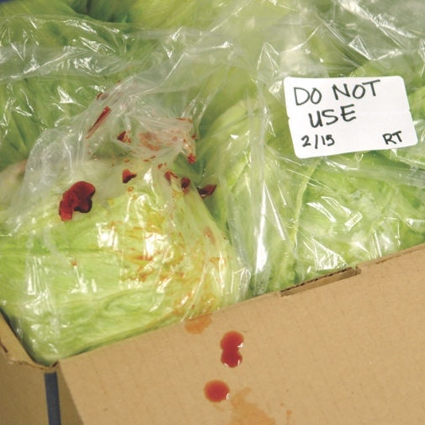
How Food Becomes Unsafe
Cross-contamination can cause a foodborne illness when:
Contaminated ingredients are added to food that receives no further cooking.
Ready-to-eat food touches contaminated surfaces.
Contaminated food touches or drips fluids onto cooked or ready-to-eat food.
A food handler touches contaminated food and then touches ready-to-eat food.
Contaminated wiping cloths touch food-contact surfaces.
1-17

Slide 19
How Food Becomes Unsafe
Poor personal hygiene can cause a foodborne illness when food handlers:
Fail to wash their hands correctly after using the restroom
Cough or sneeze on food
Touch or scratch wounds and then touch food
Work while sick
1-18

Slide 20
How Food Becomes Unsafe
Poor cleaning and sanitizing:
Equipment and utensils are not washed, rinsed, and sanitized between uses.
Food-contact surfaces are wiped clean instead of being washed, rinsed, and sanitized.
Wiping cloths are not stored in a sanitizer solution between uses.
Sanitizing solutions are not at the required levels.
1-19
Notes:
Instructor Notes:
Pathogens can be spread to food if equipment has not been cleaned and sanitized correctly between uses. This can happen in the ways indicated on the slide.

Slide 21
Food Most Likely to Become Unsafe
The two types of food that are most likely to become unsafe:
TCS food
Ready-to-eat food
1-20

Slide 22
Food Most Likely to Become Unsafe
TCS food:
Food requiring time and temperature control to limit pathogen growth—“time and temperature control for safety”
1-21

Slide 23
Food Most Likely to Become Unsafe
TCS food:
1-22
Notes:
Instructor Notes
The list of TCS food includes the following:
Milk and dairy products
Shell eggs (except those treated to eliminate nontyphoidal Salmonella)
Meat: beef, pork, and lamb
Poultry
Fish
Shellfish and crustaceans

Slide 24
Food Most Likely to Become Unsafe
TCS food:
1-23
Notes:
Instructor Notes
The list of TCS food includes the following:
Baked potatoes
Heat-treated plant food, such as cooked rice, beans, and vegetables
Tofu or other soy protein; synthetic ingredients, such as textured soy protein in meat alternatives
Sprouts and sprout seeds
Sliced melons; cut tomatoes; cut leafy greens
Untreated garlic-and-oil mixtures

Slide 25
Food Most Likely to Become Unsafe
Ready-to-eat food is food that can be eaten without further:
Preparation
Washing
Cooking
Ready-to-eat food includes:
Cooked food
Washed fruit and vegetables (whole and cut)
Deli meat
Bakery items
Sugar, spices, and seasonings
1-24
Notes:
Instructor Notes
Like TCS food, ready-to-eat food also needs careful handling to prevent contamination.

Slide 26
Populations at High Risk for Foodborne Illnesses
These people have a higher risk of getting a foodborne illness:
Preschool-age children
Elderly people
People with compromised immune systems
1-25
Notes:
Instructor Notes
As people age, changes occur in their organs. For example, stomach-acid production decreases as people get older. This allows more pathogens to enter the intestines. A change in the stomach and intestinal tract also allows the body to store food for longer periods. This gives toxins more time to form.
Very young children are at high risk because they have not built up strong immune systems.
The immune system is the body’s defense against illness.
Certain medical conditions and medications can weaken a person’s immune system—the body’s defense system against illness. These conditions and medications include:
• Cancer or chemotherapy
• HIV/AIDS
• Transplants
People who have had transplants take medication to prevent the body from rejecting the new organ or bone marrow.

Slide 27
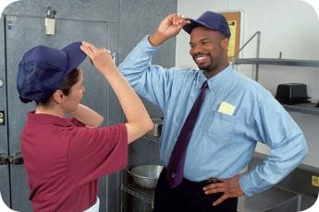
Keeping Food Safe
The Person in Charge must:
Be a Certified Food Protection Manager
Be onsite during operating hours
Show that they have the required knowledge
1-26
Notes:
Instructor Notes
Staff aren’t the only ones who need training to keep food safe. The FDA Food Code requires the Person in Charge of a foodservice operation to become a Certified Food Protection Manager. That comes with a few requirements. First, managers must be onsite at all times during operating hours and be able to show that they have the required knowledge.

Slide 28
Keeping Food Safe
To become a Certified Food Protection Manager:
You must pass a test from an accredited program
The program must be accredited by an agency approved by a Conference for Food Protection
Completing this course and passing the ServSafe exam meets this requirement
1-27
Notes:
Instructor Notes
To become a Certified Food Protection Manager you must pass a test from an accredited program. The program must be accredited by an agency approved by a Conference for Food Protection. Completing the ServSafe Manager Course and passing the ServSafe Food Protection Manager Certification Examination meets this requirement.

Slide 29
Keeping Food Safe
Why is it important to be a Certified Food Protection Manager:
CDC study suggests that it:
reduces the risk of foodborne illness.
was a distinguishing factor between restaurants that experienced an outbreak and those that had not.
FDA studies suggest that more effective control of risk factors for foodborne illness.
1-28
Notes:
Instructor Notes
But, why is it so important to become certified? A Centers for Disease Control and Prevention study suggests that the presence of a Certified Food Protection Manager reduces the risk of a foodborne illness outbreak for an establishment. The study also suggests that it was a distinguishing factor between restaurants that experienced a foodborne illness outbreak and those that had not.
Also, the FDA's Retail Food Risk Factor Studies suggest that the presence of a Certified Food Protection Manager has a positive correlation with more effective control of certain risk factors, such as poor personal hygiene, in different facility types.

Slide 30
Key Practices for Ensuring Food Safety
Focus on these measures:
Purchasing from approved, reputable suppliers
Controlling time and temperature
Preventing cross-contamination
Practicing personal hygiene
Cleaning and sanitizing
1-29
Notes:
Instructor Notes
Set up standard operating procedures that focus on these areas. The ServSafe program will show you how to design these procedures.

Slide 31
Food Safety Responsibilities of a Manager
FDA-recommended responsibilities:
Food handlers are regularly monitoring food temperatures during hot and cold holding.
Ensure food is not prepared in a private home or where people are living or sleeping.
Restrict people other than food handlers from prep, storage, and dishwashing areas.
Ensure maintenance and delivery workers follow food safety practices.
Monitor staff handwashing.
1-30
Notes:
Instructor Notes
The Food and Drug Administration (FDA) recommends that regulatory authorities hold the person in charge of a foodservice operation responsible for ensuring the standards on this and the following slides are met.
People other than food handlers are restricted from prep, storage, and dishwashing areas. If other people are allowed in these areas, steps must be taken to protect food, utensils, and equipment from contamination.

Slide 32
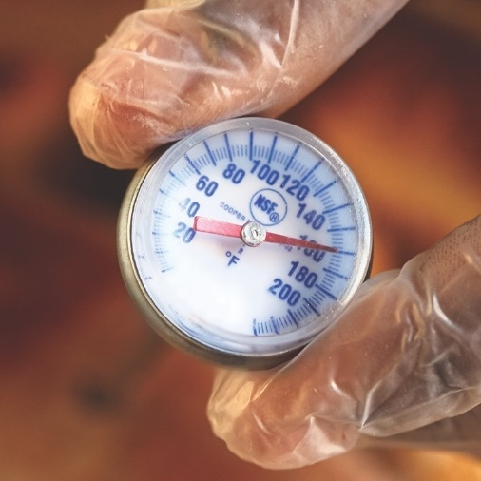
Food Safety Responsibilities of a Manager
FDA-recommended responsibilities:
Monitor deliveries to ensure food is safe.
Approved source
Correct temperature
Protected from contamination
Accurately presented
Ensure TCS food is cooked and cooled correctly.
Cooked to required temperatures
Temperatures are checked with calibrated thermometers
Food is cooled rapidly
1-31
Notes:
Instructor Notes
The inspection of deliveries is monitored to ensure that food is received from an approved source, is received at the correct temperature, and has not been contaminated.
Food delivered after-hours is monitored to make sure it is received from an approved source, stored in the correct location, protected from contamination, and accurately presented.
Food handlers are monitored to make sure TCS food is cooked to required temperatures.
Temperatures are checked using calibrated thermometers.
Food handlers are monitored to make sure TCS food is cooled rapidly.

Slide 33
Food Safety Responsibilities of a Manager
FDA-recommended responsibilities:
Ensure guests are properly notified.
Consumer advisories for raw or partially cooked food
Use of clean tableware in a self-service areas
Monitor staff and ensure training on food safety practices, including the following.
Cleaning and sanitizing
Handling ready-to-eat food
Allergy awareness
Reporting illnesses and symptoms
Food safety procedures are written down, implemented, and maintained.
1-32
Notes:
Instructor Notes
Cleaning and sanitizing procedures are monitored to make sure that sanitizer solutions are at the correct temperature and concentration and remain in contact with items for the correct amount of time.
Staff are handling ready-to-eat food with utensils or single-use gloves.
Staff are trained in food safety, including allergy awareness.
Staff, including conditional staff, are reporting illnesses and symptoms of illnesses that can be transmitted through food.
Food safety procedures are written down, implemented, and maintained where required by the regulatory authority.

Slide 34
Marketing Food Safety
Display your commitment to food safety:
Offer training.
Evaluate and update it as needed.
Discuss food safety expectations.
Document and maintain food-handling procedures.
Consider awards and rewards for good food safety records.
Set a good example.
1-33
Notes:
Instructor Notes
Marketing your food safety efforts will show staff and guests alike that you take food safety seriously. Emphasize your support of food safety training and policies.
Offer training courses and evaluate and update them as needed.
Discuss food safety expectations. Document food-handling procedures and update them as needed.
Consider awarding certificates for training and small rewards for good food safety records.
Set an example by following all food safety rules yourself.
You should also show guests that staff know and follow food safety rules. Make sure your staff’s hygiene and appearance reflect your food safety focus. Post food safety ideas and information in appropriate locations at your operation. Ensure that staff can answer simple food safety questions when asked.

