Slide 2
Objectives
Identify the following:
Time and temperature requirements for holding hot and cold TCS food
Ways of preventing time-temperature abuse and cross-contamination when displaying and serving food
The requirements for using time rather than temperature as the only method of control when holding TCS food
Ways of minimizing bare-hand contact with ready-to-eat food
9-2

Slide 3
Objectives
Identify the following:
How to prevent staff from contaminating food during service
How to prevent guests from contaminating self-service areas
The possible hazards of transporting food and ways of preventing them
The possible hazards of serving food offsite and ways of preventing them
The possible hazards of vending food and ways of preventing them
9-3

Slide 4
General Rules for Holding Food
Temperature and thermometer:
Hold TCS food at the correct temperature:
Hot food: 135˚F (57˚C) or higher
Cold food: 41˚F (5˚C) or lower
Use a thermometer to check a food’s internal temperature.
NEVER use the temperature gauge on a holding unit to check the food’s temperature.
9-4
Notes:
Instructor Notes
Use a thermometer to check a food’s internal temperature. Never use the temperature gauge on a holding unit to do it. The gauge does not check the internal temperature of the food.

Slide 5
Guidelines for Holding Food
Time:
Make sure staff are monitoring holding temperatures regularly.
Check temperatures at least every four hours:
Throw out food not at 41˚F (5˚C) or lower or 135˚F (57˚C) or higher.
Optional: Check temperatures every two hours to leave time for corrective action.
9-5
Notes:
Instructor Notes
Make sure that food handlers are regularly monitoring food temperatures during hot and cold holding.
You can check the temperature every two hours. This will leave time for corrective action. For example, hot TCS food that has been held below 135°F (57°C) can be reheated and then placed back in the hot-holding unit.

Slide 6
General Rules for Holding Food
Reheating food:
NEVER use hot-holding equipment to reheat food unless it’s built to do so.
Reheat food correctly, and then move it into a holding unit.
9-6
Notes:
Instructor Notes
Most hot-holding equipment does not pass food through the temperature danger zone quickly enough.

Slide 7
General Rules for Holding Food
Food covers and sneeze guards:
Cover food and install sneeze guards to protect food from contaminants.
Covers protect food from contamination and help maintain food temperatures.
Policies:
Create policies about how long the operation will hold food and when it will be thrown out.
9-7

Slide 8
Holding Food Without Temperature Control
Cold food can be held without temperature control for up to six hours if:
It was held at 41˚F (5˚C) or lower before removing it from refrigeration.
It has a label specifying:
Time it was removed from refrigeration
Time it must be thrown out
It does not exceed 70˚F (21˚C) during service.
Throw out food that exceeds this temperature.
It is sold, served, or thrown out within six hours.
9-8
Notes:
Instructor Notes
Your operation may want to display or hold TCS food without temperature control.
If you primarily serve a high-risk population, you cannot hold TCS food without temperature control.
If your operation displays or holds TCS food without temperature control, it must do so under certain conditions. Before using time as a method of control, check with your local regulatory authority for specific requirements.
For cold food, label the food with the time you removed it from refrigeration and the time you must throw it out. The discard time on the label must be six hours from the time you removed the food from refrigeration.
For example, if you remove potato salad from refrigeration at 3:00 p.m. to serve at a picnic, the discard time on the label should be 9:00 p.m. This equals six hours from the time you removed it from refrigeration.

Slide 9
Holding Food without Temperature Control
Hot food can be held without temperature control for up to four hours if:
It was held at 135˚F (57˚C) or higher before removing it from temperature control.
It has a label specifying when the item must be thrown out.
It is sold, served, or thrown out within four hours.
9-9
Notes:
Instructor Notes
For hot food, the discard time on the label must be four hours from the time you removed the food from temperature control.

Slide 10
Holding Food without Temperature Control
To get regulatory approval:
Prepare written procedures.
Get written approval in advance.
Maintain procedures.
Make procedures available.
9-10
Notes:
Instructor Notes
Before using time as a method of control, check with your local regulatory authority for specific requirements. The regulatory authority may require you to prepare written procedures and get written approval in advance. You will also need to maintain those procedures in the operation, and make sure they are made available to the regulatory authority upon request.

Slide 11
Service Staff Guidelines for Serving Food
Handling dishes and glassware
Correct
Incorrect
9-11
Notes:
Instructor Notes
Service staff must be as careful as kitchen staff. They can contaminate food simply by handling the food-contact areas of glasses, dishes, and utensils. Service staff should use these guidelines when serving food.
Hold dishes by the bottom or edge. Hold glasses by the middle, bottom, or stem. Do NOT touch the food-contact areas of dishes or glassware.
Carry glasses in a rack or on a tray to avoid touching the food-contact surfaces. Do NOT stack glasses when carrying them.
Hold flatware by the handle. Do NOT hold flatware by food-contact surfaces. Store flatware so that servers grasp handles, not food-contact surfaces.
Avoid bare-hand contact with food that is ready to eat.
Use ice scoops or tongs to get ice. NEVER scoop ice with your bare hands or a glass. A glass may chip or break.

Slide 12
Service Staff Guidelines for Serving Food
If you preset tableware:
Wrap or cover the items to prevent contamination.
Table settings do not need to be wrapped or covered if extra settings are:
Removed when guests are seated.
If left on the table, cleaned and sanitized after guests have left.
9-12
Notes:
Instructor Notes
Table settings do not need to be wrapped or covered if extra settings meet these requirements.
They are removed when guests are seated.
If they remain on the table, they are cleaned and sanitized after guests have left.

Slide 13
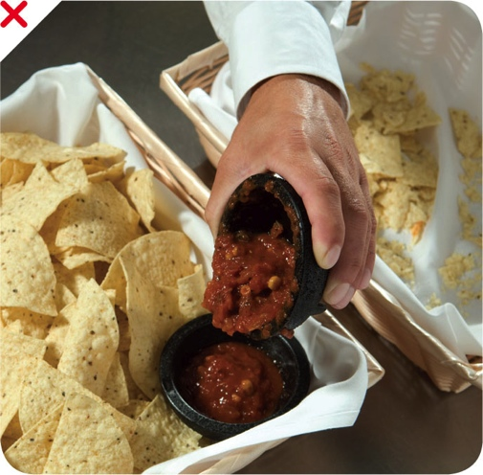
Service Staff Guidelines for Serving Food
NEVER re-serve:
Food returned by a guest
Uncovered condiments
Uneaten bread
Plate garnishes
Generally only unopened, prepackaged food in good condition can be re-served:
Condiment packets
Wrapped crackers or breadsticks
9-13
Notes:
Instructor Notes
You must protect condiments from contamination. Serve them in their original containers or in containers designed to prevent contamination. Offering condiments in individual packets or portions can also help keep them safe.
Never re-serve uncovered condiments. Do NOT combine leftover condiments with fresh ones. Throw away opened portions or dishes of condiments after serving them to customers. Salsa, butter, mayonnaise, and ketchup are examples.
Change linens used in bread baskets after each customer.
In general, only unopened prepackaged food can be re-served. That includes condiment packets, wrapped crackers or breadsticks, and bottles of ketchup and mustard. The containers must remain closed between uses.

Slide 14
Kitchen Staff Guidelines for Serving Food
Prevent contamination when serving food:
Avoid bare-hand contact with ready-to-eat food:
Wear single-use gloves.
Use spatulas, tongs, deli sheets, or other utensils.
Use clean and sanitized utensils for serving:
Use separate utensils for each food.
Clean and sanitize utensils after each task.
If using them continuously, clean and sanitize them at least every four hours.
9-14
Notes:
Instructor Notes
The biggest threat to food that is ready to be served is contamination. Train your kitchen staff to follow these guidelines when serving food to avoid contamination.
Keep in mind that there are some situations where it may be acceptable to handle ready-to-eat food with bare hands, such as when a dish does not contain raw meat, seafood, or poultry and will be cooked to at least 145ºF (63ºC).

Slide 15
Kitchen Staff Guidelines for Serving Food
Prevent contamination when serving food:
Store serving utensils correctly between uses:
Leave them in the food with the handle extended above the container rim.
Place them on a clean and sanitized food-contact surface.
Optional: Store spoons or scoops under running water or in a container of water at least 135ºF (57ºC).
9-15
Notes:
Instructor Notes
Spoons or scoops used to serve food such as ice cream or mashed potatoes can be stored under running water. They can also be stored in a container of water that is maintained at a temperature of at least 135ºF (57ºC).

Slide 16
Kitchen Staff Guidelines for Serving Food
Prevent contamination when serving food:
Take-home containers can be refilled only when the containers are:
Designed for reuse
Provided to guest by the operation
Cleaned and sanitized correctly
9-16
Notes:
Instructor Notes
Some jurisdictions allow food handlers to refill take-home containers brought back by a guest with food and beverages. Take-home containers can be refilled if they meet the conditions on the slides.

Slide 17
Kitchen Staff Guidelines for Serving Food
Prevent contamination when serving food:
Take-home beverage containers can be refilled if the:
Beverage is not a TCS food.
Container is refilled for the same guest.
Container can be effectively cleaned.
Container is rinsed with fresh, hot water under pressure before refilling.
Container is refilled by staff in the operation or by the guest using a process that prevents contamination.
9-17
Notes:
Instructor Notes
The container has to be capable of being effectively cleaned at home and in the operation.

Slide 18
Self-Service Areas
Prevent contamination in self-service areas:
Use sneeze guards, display cases, or packaging.
Use labels to identify food items.
Keep raw meat, fish, and poultry separate from ready-to-eat food.
9-18
Notes:
Instructor Notes
Food on display can be protected from contamination using sneeze guards. Food can also be protected by placing it in display cases or by packaging it in a way that will protect it from contamination.
Whole, raw fruits and vegetables and nuts in the shell that require peeling or hulling before eating do not require the these protection measures.
Label food located in self-service areas. For example, place the name of the food, such as types of salad dressing, on ladle handles or signs.
Typically, raw, unpackaged meat, poultry, and seafood cannot be offered for self-service. However the following items are exceptions to this rule: ready-to-eat food at buffets or salad bars that serve food such as sushi or raw shellfish; ready-to-cook portions that will be cooked and eaten immediately on the premises, such as at Mongolian barbecues; raw, frozen, shell- on shrimp or lobster.

Slide 19
Self-Service Areas
Prevent contamination in self-service areas:
Do NOT let customers refill dirty plates or use dirty utensils at self-service areas.
Stock displays with the correct utensils.
NEVER use ice as an ingredient if it was used to keep food or beverages cold.
9-19
Notes:
Instructor Notes
Assign a staff member to monitor guests. Post signs reminding guests not to reuse plates and utensils.
Stock food displays with the correct utensils for dispensing food. This might include tongs, ladles, or deli sheets.

Slide 20
Self-Service Areas
Label bulk food in self-service areas:
Make sure the label is in plain view of the guest.
Include the manufacturer or processor label provided with the food.
As an alternative, provide the information using a card, sign, or other labeling method.
9-20

Slide 21
Self-Service Areas
A label is not needed for bulk unpackaged food, such as bakery products, if:
The product makes no claim regarding health or nutrient content.
No laws require the item to be labeled.
The food is manufactured or prepared on the premises.
The food is manufactured or prepared at another operation or processing plant owned by the same person.
The operation must also be regulated.
9-21
Notes:
Instructor Notes
Bulk unpackaged food, such as bakery products and unpackaged food portioned for customers, does not need to be labeled if it meets the conditions identified in the slide.

Slide 22
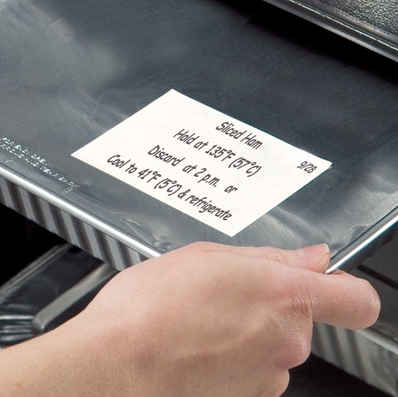
Off-Site Service
When transporting food off-site:
Use insulated, food-grade containers designed to keep food from mixing, leaking, and spilling.
Label food with a use-by date and time, and reheating and service instructions.
Clean the inside of delivery vehicles regularly.
Check internal food temperatures.
9-22
Notes:
Instructor Notes
Delays from the point of preparation to the point of service increase the risk that food will be exposed to contamination or time-temperature abuse.
At the service site, use appropriate containers or equipment to hold food at the correct temperature.
Check internal food temperatures. If containers or delivery vehicles are not holding food at the correct temperature, reevaluate the length of the delivery route or the efficiency of the equipment being used.

Slide 23
Off-Site Service
When transporting food off-site:
Practice good personal hygiene.
Check internal food temperatures.
If they are not being held correctly, reevaluate the length of the delivery route or the equipment.
Store raw meat, poultry, and seafood separate from ready-to-eat items.
9-23

Slide 24
Off-Site Service
When catering:
Make sure the service site has the correct utilities:
Safe water for cooking, dishwashing, and handwashing
Garbage containers stored away from food-prep, storage, and serving areas
Use insulated containers to hold TCS food:
Wrap raw meat and store it on ice.
Deliver dairy products in a refrigerated vehicle or on ice.
9-24
Notes:
Instructor Notes
Caterers must follow the same food safety rules as permanent operations. Food must be protected from contamination and time-temperature abuse.

Slide 25
Off-Site Service
When catering:
Serve cold food in containers on ice or in chilled containers.
Optional: Hold food without temperature control according to guidelines.
Store ready-to-eat food separately from raw food.
Provide customers with directions for handling leftovers.
9-25
Notes:
Instructor Notes
Serve cold food in containers on ice or in chilled, gel-filled containers. If that is not desirable, the food may be held without temperature control according to the guidelines specified in this chapter.
If leftovers are given to guests, provide instructions on how they should be handled. Information such as a discard date and the food’s storage and reheating instructions should be clearly labeled on the container.

Slide 26
Off-Site Service
Guidelines for temporary units:
Construct temporary units to keep out dirt and pests.
Apply food safety rules to food prep.
Make sure safe drinking water is available for cleaning, sanitizing, and handwashing.
Use disposable, single-use items.
9-26
Notes:
Instructor Notes
Temporary units typically operate in one location for less than 14 days. Foodservice tents or kiosks set up for food fairs, special celebrations, or sporting events may be temporary units.
In some areas, the definition also extends to units set up for longer periods. Temporary units usually serve prepackaged food or food requiring limited prepping, such as hot dogs. It is best to keep the menu simple to limit the amount of on-site food prep. Check with your regulatory authority for operating requirements.
Temporary units should be constructed to keep out dirt and pests. If floors are made of dirt or gravel, cover them with mats or platforms to control dust and mud. Construct walls and the ceiling with materials that will protect food from weather and windblown dust.
Because dishwashing facilities will likely be limited, too, it is best to use disposable, single-use items.

Slide 27
Off-Site Service
Guidelines for mobile units:
Sanitation requirements may vary based on the products
The same food safety rules apply to permanent and mobile kitchens
Special permit or license may be needed
9-27
Notes:
Instructor Notes
Mobile units are portable facilities ranging from concession vans to elaborate field kitchens. Those serving only frozen novelties, candy, packaged snacks, and soft drinks need to meet basic sanitation requirements.
However, mobile kitchens prepping and serving TCS food need to follow the same rules required of permanent foodservice kitchens. Both types of operations might be required to apply for a special permit or license from the regulatory authority.

Slide 28
Vending Machines
To keep vended food safe:
Check product shelf life daily:
Throw away food past its expiration or use-by date.
Throw away refrigerated food prepped on-site and not sold in seven days.
Keep TCS food at the correct temperature.
Dispense TCS food in its original container.
Wash and wrap fresh fruit with edible peels before putting it in the machine.
9-28
Notes:
Instructor Notes
Vending operators should protect food from contamination and time-temperature abuse. This is especially important when prepping and packaging food and during transport and delivery.
Check product shelf life daily. Products often have a code date, such as an expiration or a use-by date. If the date has expired, throw out the food immediately. Throw out refrigerated food prepped on-site if not sold within seven days of preparation.
Keep TCS food at the correct temperature. It should be held at 41°F (5°C) or lower, or at 135°F (57°C) or higher. The machines must have controls that prevent TCS food from being dispensed if the temperature stays in the danger zone for a specified amount of time. This food must be thrown out.

