Slide 2
Objectives
Identify the following:
Correct ways for prepping food to prevent cross-contamination and time-temperature abuse
Safe methods for thawing food
The minimum internal cooking temperatures for TCS food
The correct way to cook TCS food in a microwave oven
8-2

Slide 3
Objectives
Identify the following:
The importance of informing consumers of risks when serving raw or undercooked food
Requirements for partially cooking TCS food
Methods and time-temperature requirements for cooling TCS food
Time and temperature requirements for reheating TCS food
8-3

Slide 4
General Preparation Practices
When prepping food:
Make sure workstations, cutting boards, and utensils are clean and sanitized.
Only remove as much food from the cooler as you can prep in a short period of time.
This prevents time-temperature abuse.
Return prepped food to the cooler or cook it as quickly as possible.
8-4

Slide 5
General Preparation Practices
Food and color additives:
Only use additives approved by your local regulatory authority.
NEVER use more additives than are allowed by law.
NEVER use additives to alter the appearance of food.
Do NOT sell produce treated with sulfites before it was received in the operation.
Do NOT add sulfites to produce that will be eaten raw.
8-5

Slide 6
General Preparation Practices
Present food honestly:
Do NOT use the following to misrepresent the appearance of food:
Food additives or color additives
Colored overwraps
Lights
Food must be presented in the way it was described.
For example, if a menu offers “Fried Perch,” another fish cannot be substituted.
Food not presented honestly must be thrown out.
8-6
Notes:
Instructor Notes
Food must be offered to customers in a way that does not mislead or misinform them. Customers must be able to judge the true appearance, color, and quality of food.

Slide 7
General Preparation Practices
Corrective actions:
Food must be thrown out in the following situations:
When it is handled by staff who have been restricted or excluded from the operation due to illness
When it is contaminated by hands or bodily fluids from the nose or mouth
When it has exceeded the time and temperature requirements designed to keep food safe
8-7
Notes:
Instructor Notes
Food that has become unsafe must be thrown out unless it can be safely reconditioned. All food—especially ready-to-eat food—must be thrown out in the situations highlighted in the slide.
Sometimes food can be restored to a safe condition. This is called reconditioning. For example, a hot food that has not been held at the correct temperature may be reheated if it has not been in the temperature danger zone for more than two hours.

Slide 8
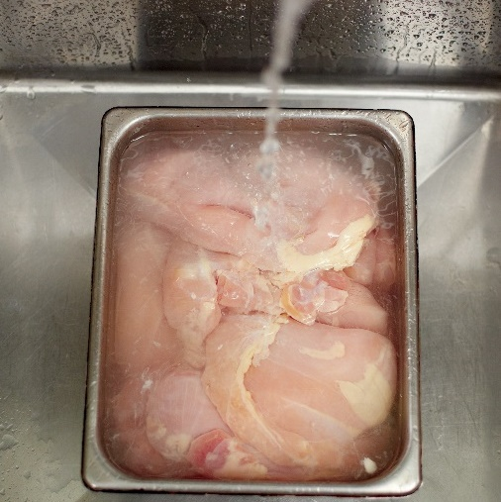
Thawing
General guidelines for TCS food:
Thaw food in a cooler, keeping its temperature at 41˚F (5˚C) or lower.
Submerge food under running, drinkable water at 70˚F (21˚C) or lower:
Use a clean and sanitized food-prep sink.
Use water flow strong enough to wash away food bits.
Never let the temperature of the food go above 41˚F (5˚C) for longer than four hours.
8-8
Notes:
Instructor Notes
When frozen food is thawed and exposed to the temperature danger zone, pathogens in the food will begin to grow. To reduce this growth, NEVER thaw food at room temperature.
Thaw food in a cooler, keeping its temperature at 41ºF (5ºC) or lower. This requires advance planning. Larger items, such as a turkey, can take several days to thaw completely in a cooler.
When thawing food under running water, the flow of the water must be strong enough to wash loose food bits into the drain. Always use a clean and sanitized food-prep sink when thawing food this way. Never let the temperature of the food go above 41°F (5°C) for longer than four hours. This includes the time it takes to thaw the food plus the time it takes to prep or cool it. The photo shows the correct way to thaw food under running water.

Slide 9
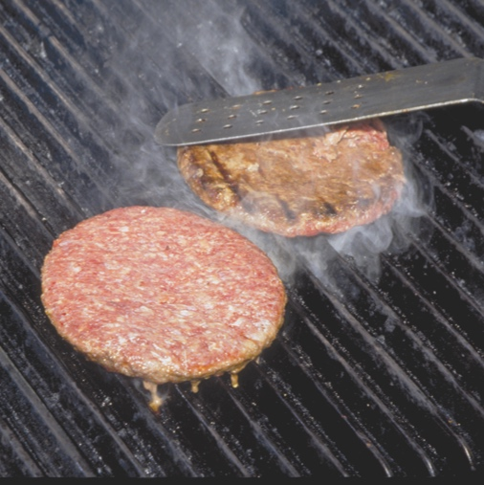
Thawing
General guidelines for TCS food:
Thaw food in a microwave.
Cook it in conventional cooking equipment immediately after thawing.
Thaw food as part of the cooking process.
Some foods may be slacked before cooking.
Do not let the food get warmer than 41ºF (5ºC).
8-9
Notes:
Instructor Notes
After food is thawed in a microwave oven, it must be cooked in conventional cooking equipment, such as an oven.
Thaw food as part of the cooking process. For example, frozen hamburger patties can go straight from the freezer onto a grill without first being thawed. Frozen chicken can go straight into a deep fryer. These items cook quickly enough from the frozen state to pass through the temperature danger zone without harm. However, always verify the final internal cooking temperature with a thermometer.
Some frozen food may also be slacked before cooking. Slacking is the gradual thawing of frozen food to prep it for deep-frying. This allows even heating during cooking. For example, you might slack frozen breaded chicken breasts by having them warm from –10°F (–23°C) to 25°F (–4°C).
Slack food just before you cook it. Do not let it get any warmer than 41°F (5°C). If your regulatory authority allows slacking at room temperature, have a system that ensures the item does not exceed 41°F (5°C).

Slide 10
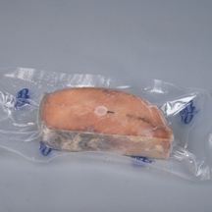
Thawing ROP Fish
Frozen fish received in ROP packaging must be thawed carefully.
If the label states that the product must remain frozen until use, then remove fish from packaging:
Before thawing under refrigeration
Before or immediately after thawing under running water
8-10
Notes:
Instructor Notes
Because of concerns about the potential for Botulism, frozen fish in ROP packaging has special handling practices.

Slide 11
Prepping Specific Food
If packaging fish using a reduced-oxygen packaging method, the fish must:
Be frozen before, during, or after packaging
Include a label that states the fish must be frozen until used
8-11

Slide 12
Prepping Specific Food
When prepping meat, seafood, poultry:
Use clean and sanitized work areas, cutting boards, knives, and utensils.
Prep raw meat, poultry, and seafood separately or at different times from fresh produce.
Remove only as much food as can be prepped at one time.
Return raw meat to the cooler as quickly as possible after prepping it.
8-12

Slide 13
Prepping Specific Food
When prepping salads containing TCS food:
Prep the food in small batches.
Only use leftover TCS ingredients (e.g., pasta, chicken, potatoes) that have been handled safely:
Cooked, held, and cooled correctly
Stored for less than seven days at 41˚F (5˚C) or lower
8-13
Notes:
Instructor Notes
Chicken, tuna, egg, pasta, and potato salads all have been involved in foodborne-illness outbreaks. These salads usually are not cooked after preparation. This means you do not have a chance to reduce pathogens that may have gotten into the salad.
Prep food in small batches so large amounts of food do not sit out at room temperature for long periods of time.
Check the use-by date before using leftover TCS food in salads.

Slide 14
Prepping Specific Food
When prepping salads containing TCS food:
Consider chilling ingredients and utensils before use.
Leave food in the cooler until all ingredients will be mixed.
8-14

Slide 15
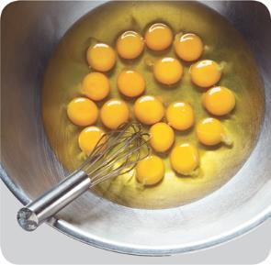
Prepping Specific Food
When prepping eggs and egg mixtures:
Handle pooled eggs (if allowed) with care:
Cook promptly after mixing or store at 41˚F (5˚C) or lower.
Clean and sanitize containers between batches.
Consider using pasteurized shell eggs or egg products for dishes that need little or no cooking.
Promptly clean and sanitize equipment used to prep eggs.
8-15
Notes:
Instructor Notes
All untreated eggs are considered TCS food. They are able to support the rapid growth of bacteria.
Pooled eggs are eggs that are cracked open and combined in a container.
Check with your local regulatory authority to see if pooling eggs is allowed.
Egg dishes requiring little or no cooking include Caesar salad dressing, Hollandaise sauce, tiramisu, and mousse.

Slide 16
Prepping Specific Food
When prepping eggs and egg mixtures:
Take special care when serving a high-risk population:
Use pasteurized eggs or egg products when serving raw or undercooked dishes.
Unpasteurized shell eggs can be used if the dish will be cooked all the way through (e.g., omelets, cakes).
Use pasteurized shell eggs if eggs will be pooled.
Promptly clean and sanitize all equipment and utensils used to prep eggs.
8-16

Slide 17
Prepping Specific Food
When prepping battered or breaded food:
Prep batter in small batches.
Store unused batter as quickly as possible.
Throw out unused batter or breading after a set amount of time.
Cooke food thoroughly.
When deep frying:
Make sure the oil temperature recovers before loading each batch.
Do NOT overload fryer baskets.
Monitor oil and food temperatures and cooking times.
8-17
Notes:
Instructor Notes
Batters or breading prepped with eggs or milk run the risk of time-temperature abuse and cross-contamination.
If you have leftover batter, store what you don’t need at 41ºF (5ºC) or lower in a covered container.
Create a plan to throw out any unused batter or breading after at set time. This might be after using a batch or at the end of a shift.
The coating of battered and breaded food acts as an insulator that can prevent food from being thoroughly cooked.
When deep-frying, monitor oil and food temperatures using calibrated thermometers.

Slide 18
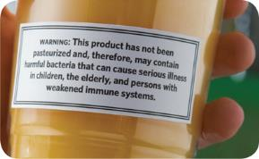
Prepping Specific Food
To package fresh juice for later sale:
The juice must be treated (e.g., pasteurized) according to an approved HACCP plan.
As an alternative, the juice can be labeled with this warning:
Warning: This product has not been pasteurized and, therefore, may contain harmful bacteria that can cause serious illness in children, the elderly, and people with weakened immune systems.
8-18

Slide 19
Prepping Specific Food
Produce:
Make sure produce does not touch surfaces exposed to raw meat, seafood, or poultry.
Wash the produce thoroughly before cutting, cooking, or combining it with other ingredients.
To wash produce:
Use running water a little warmer than the produce.
Pull apart leafy greens and rinse thoroughly.
Certain chemicals may be used to wash produce.
8-19
Notes:
Instructor Notes
Prep produce away from raw meat, poultry, and seafood, as well as from ready-to-eat food.
Clean and sanitize the work space and all utensils that will be used before and after prepping produce.
Wash produce thoroughly under running water. This is especially important before cutting, cooking, or combining it with other ingredients. The water should be a little warmer than the produce.
Pay special attention to leafy greens such as lettuce and spinach. Remove the outer leaves, and pull the lettuce or spinach completely apart and rinse thoroughly.
Certain chemicals may be used to wash fruits and vegetables. Also, produce can be treated by washing it in water containing ozone. This treatment helps control pathogens. Your local regulatory authority can tell what is acceptable to use for this.

Slide 20
Prepping Specific Food
Produce:
When soaking or storing produce in standing water or an ice-water slurry, do NOT mix:
Different items
Multiple batches of the same item
Refrigerate and hold cut melons, cut tomatoes, and cut leafy greens at 41˚F (5˚C) or lower.
Do NOT serve raw seed sprouts if primarily serving a high-risk population.
8-20
Notes:
Instructor Notes
Refrigerate and hold cut melons, cut tomatoes, and cut leafy greens at 41°F (5°C) or lower. They are TCS food. Many operations hold other fresh-cut produce at this temperature as well.

Slide 21
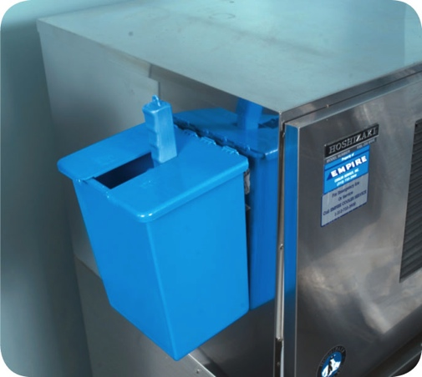
Prepping Specific Food
Ice:
Make ice from water that is safe to drink.
NEVER use ice as an ingredient if it was used to keep food cold.
Use clean and sanitized containers and scoops.
Store scoops outside of the ice machine in a clean, protected location.
NEVER hold ice in containers that held chemicals or raw meat, seafood, or poultry.
NEVER touch ice with hands or use a glass to scoop ice.
8-21
Notes:
Instructor Notes
Make ice from water that is safe to drink.
NEVER use ice as an ingredient if it was used to keep food cold. For example, if ice is used to cool food on a salad bar, it cannot then be used in drinks.

Slide 22
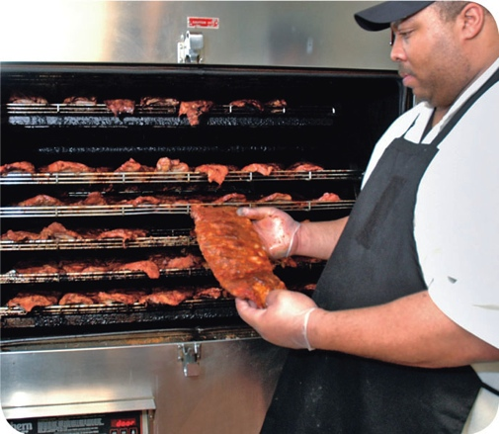
Preparation Practices That Have Special Requirements
You need a variance if prepping food in these ways:
Packaging fresh juice on-site for sale at a later time, unless the juice has a warning label
Smoking food to preserve it but not to enhance flavor
Using food additives or components to preserve or alter food so it no longer needs time and temperature control for safety
Curing food
8-22
Notes:
Instructor Notes
You will need a variance when prepping food in certain ways. A variance is a document issued by your regulatory authority that allows a regulatory requirement to be waived or changed.

Slide 23
Preparation Practices That Have Special Requirements
You need a variance if prepping food in these ways:
Custom-processing animals for personal use (e.g., dressing a deer)
Packaging food using a reduced-oxygen packaging (ROP) method
Sprouting seeds or beans
Offering live shellfish from a display tank
8-23
Notes:
Instructor Notes
Reduced-oxygen packaging (ROP) include includes MAP, vacuum-packed, and sous vide food, as shown in the photo.

Slide 24
Preparation Practices That Have Special Requirements
A HACCP plan may be required when applying for a variance:
• The plan must account for food safety risks
• The establishment must comply with the plan and procedures
• Records must be provided and maintained
8-24
Notes:
Instructor Notes
When applying for a variance, your regulatory authority may require you to submit a HACCP plan. The plan must meet the requirements in the slide.
The HACCP plan must account for any food safety risks related to the way you plan to prep the food item.
You must comply with the HACCP Plan and procedures submitted.

Slide 25
Preparation Practices That Have Special Requirements
Records must show that you are regularly:
• Following procedures for monitoring Critical Control Points
• Monitoring the Critical Control Points
• Verifying the effectiveness of the operation or process
• Taking the necessary corrective actions if there is a failure at a Critical Control Point
8-25
Notes:
Instructor Notes
You must maintain and provide records requested by the regulatory authority. Those records must show that you are regularly meeting the requirements listed in the slide.

Slide 26
Cooking Requirements for Specific Food
Minimum internal cooking temperature:
165˚F (74˚C) for <1 second (Instantaneous)
Poultry—whole or ground chicken, turkey, or duck
Stuffing made with fish, meat, or poultry
Stuffed meat, seafood, poultry, or pasta
Dishes that include previously cooked TCS ingredients
8-26

Slide 27
Cooking Requirements for Specific Food
Minimum internal cooking temperature:
155˚F (68˚C) for 17 seconds
Ground meat—beef, pork, and other meat
Injected meat—including brined ham and flavor-injected roasts
Mechanically tenderized meat
Ground meat from game animals commercially raised and inspected
Ratites—including ostrich and emu
Ground seafood—including chopped or minced seafood
Shell eggs that will be hot-held for service
8-27
Notes:
Instructor Notes
Ratites are mostly flightless birds with flat breastbones.

Slide 28
Cooking Food
Minimum internal cooking temperature:
145˚F (63˚C) for 15 seconds
Seafood—including fish, shellfish, and crustaceans
Steaks/chops of pork, beef, veal, and lamb
Commercially raised game
Shell eggs that will be served immediately
8-28

Slide 29
Cooking Food
Minimum internal cooking temperature:
145˚F (63˚C) for four minutes
Roasts of pork, beef, veal, and lamb
Alternate cooking times/temperatures
130˚F (54˚C) 112 minutes
131˚F (55˚C) 89 minutes
133˚F (56˚C) 56 minutes
135˚F (57˚C) 36 minutes
136˚F (58˚C) 28 minutes
138˚F (59˚C) 18 minutes
140˚F (60˚C) 12 minutes
142˚F (61˚C) 8 minutes
144˚F (62˚C) 5 minutes
8-29

Slide 30
Cooking Requirements for Specific Food
Minimum internal cooking temperature:
135˚F (57˚C) (no minimum time)
Food from plants, including fruits, vegetables, grains (e.g., rice, pasta), and legumes (e.g., beans, refried beans) that will be hot-held for service
8-30

Slide 31
Cooking Food
Minimum internal cooking temperature:
175˚F (80˚C)
Tea
Automatic iced tea and automatic coffee machine equipment:
Tea leaves should have contact with the water for at least one minute.
Traditional steeping method:
Tea leaves should be exposed to the water for about five minutes.
8-31

Slide 32
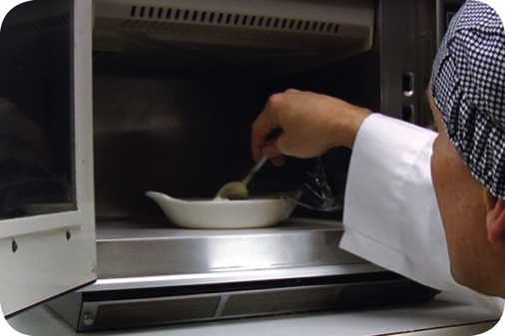
Cooking Food
Cooking TCS food in the microwave oven:
Minimum internal cooking temperature:
165˚F (74˚C)
Meat
Seafood
Poultry
Eggs
8-32

Slide 33
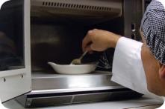
Cooking Food
Cooking TCS food in the microwave oven:
Cover the food to prevent drying.
For even cooking:
Rotate or stir food halfway through the cooking process.
Let the covered food stand for at least two minutes after cooking.
Check the temperature in at least two places.
8-33
Notes:
Instructor Notes
Cover the food to prevent its surface from drying out.
Rotate or stir it halfway through the cooking process so that the heat reaches the food more evenly.
Let the covered food stand for at least two minutes after cooking to let the food temperature even out.
Check the temperature in at least two places to make sure that the food is cooked through.

Slide 34
Cooking Food
General cooking guidelines:
Specify the cooking time and minimum internal temperature in all recipes.
Use thermometers correctly:
Correct probe
Thickest part of the food
At least two readings in different locations
Avoid overloading cooking equipment.
Let the temperature of cooking equipment recover between batches.
8-34
Notes:
Instructor Notes
Use a thermometer with a probe that is the correct size for the food. Check the temperature in the thickest part of the food, as shown in the photo. Take at least two readings in different locations.
Avoid overloading ovens, fryers, and other cooking equipment. Overloading may lower the equipment or oil temperature, and the food might not cook fully.

Slide 35
Consumer Advisories
Disclosure:
Disclose any raw or undercooked TCS items on the menu.
Note it on the menu next to the items:
An asterisk with a footnote can be used.
The footnote must state that the item is raw or undercooked, or contains raw or undercooked ingredients.
Disclosure
Reminder
8-35
Notes:
Instructor Notes:
TCS Food must be cooked to the minimum internal temperatures unless a customer requests otherwise.

Slide 36
Consumer Advisories
Reminder:
Advise customers who order raw or undercooked TCS food of the increased risk of foodborne illness:
Post a notice in the menu.
Provide this information using brochures, table tents, or signs.
Disclosure
Reminder
8-36
Notes:
Instructor Notes:
You can remind customers of the risks by posting a notice in your menu. You can also provide this information using brochures, table tents, signs, or other written methods.

Slide 37
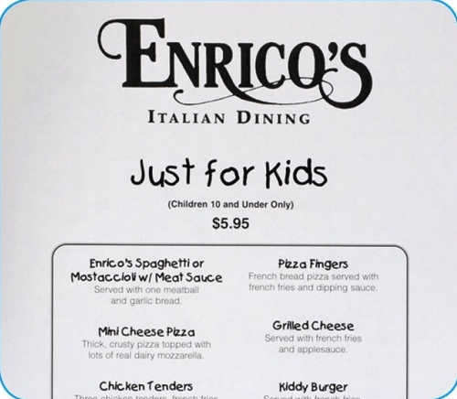
Children’s Menus
The FDA advises against offering these items on a children’s menu if they are raw or undercooked:
Meat
Poultry
Seafood
Eggs
8-37
Notes:
Instructor Notes
The Food and Drug Administration (FDA) advises against offering raw or undercooked meat, poultry, seafood, or eggs on a children’s menu. This is especially true for undercooked ground beef, which may be contaminated with Shiga toxin-producing E. coli O157:H7.

Slide 38
Operations That Mainly Serve High-Risk Populations
NEVER serve:
Raw seed sprouts
Raw or undercooked eggs (unpasteurized), meat, or seafood
Over-easy eggs
Raw oysters on the half shell
Rare hamburgers
Unpasteurized milk or juice
8-38

Slide 39
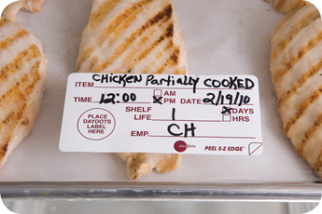
Partial Cooking During Preparation
If partially cooking meat, seafood, poultry, or eggs or dishes containing these items:
NEVER cook the food longer than 60 minutes during initial cooking.
Cool the food immediately after initial cooking.
Freeze or refrigerate the food after cooling it.
If refrigerating, hold it at 41ºF (5ºC) or lower and store it away from ready-to-eat food.
Heat the food to its required minimum internal temperature before selling or serving it.
Cool the food if it will not be served immediately or held for service.
8-39
Notes:
Instructor Notes
Some operations partially cook food during prep and then finish cooking it just before service. This is called partial cooking, or parcooking.
You must follow the steps in the slide if you plan to partially cook meat, seafood, poultry, or eggs; or dishes containing these items.

Slide 40
Partial Cooking During Preparation
Procedures for partial cooking should describe:
How to monitor and document requirements
Which corrective actions will be taken if requirements are not met
How parcooked items will be marked after initial cooking
How parcooked food will be stored separately from ready-to-eat food
8-40
Notes:
Instructor Notes
Your local regulatory authority will require you to have written procedures that explain how the food cooked by this process will be prepped and stored. These procedures must be approved by the regulatory authority and describe the items on the slide.

Slide 41
Temperature Requirements for Cooling Food
1. Cool food from 135ºF to 70ºF (57ºC to 21ºC) within two hours.
2. Cool it from 70ºF to 41ºF (21ºC to 5ºC) or lower in the next four hours.
8-41
Notes:
Instructor Notes
Pathogens grow well in the temperature danger zone. However, they grow much faster at temperatures between 125°F and 70°F (52°C and 21°C). Food must pass through this temperature range quickly to reduce this growth.
TCS food must be cooled from 135°F (57°C) to 41°F (5°C) or lower within six hours.
First, cool food from 135˚F to 70˚F (57˚C to 21˚C) within the first two hours.
Then cool it to 41˚F (5˚C) or lower in the next four hours.
If food has not cooled to 70˚F (21˚C) within two hours, it must be reheated and then cooled again.

Slide 42
Temperature Requirements for Cooling Food
If you cool food from 135˚F to 70˚F (57˚C to 21˚C) in less than two hours:
The remaining time can be used to cool it to 41˚F (5˚C) or lower.
The total cooling time cannot be longer than six hours.
Example: If you cool food from 135˚F to 70˚F (57˚C to 21˚C) in one hour, then you have five hours to get the food to 41˚F (5˚C) or lower.
8-42

Slide 43
Cooling Food
Factors that affect cooling:
Thickness or density of the food
Size of the food
Cut larger items into smaller pieces.
Divide large containers of food into smaller containers or shallow pans.
Storage container
Stainless steel transfers heat away from food faster than plastic.
Shallow pans let the heat from food disperse faster than deep pans.
8-43
Notes:
Instructor Notes
The denser the food, the more slowly it will cool.
Large food items cool more slowly than smaller items. To let food cool faster, you should reduce its size. Cut large food items into smaller pieces. Divide large containers of food into smaller containers or shallow pans,.

Slide 44
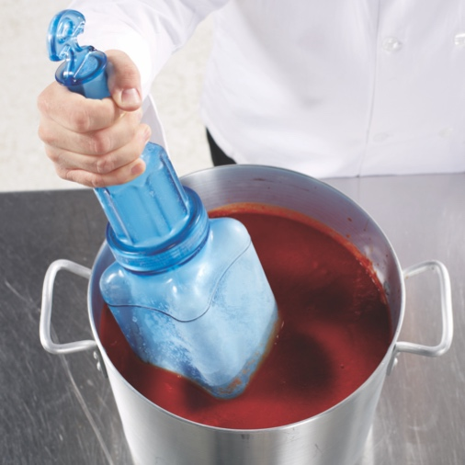
Cooling Food
Methods for cooling food:
Place food in an ice-water bath.
Place it in a blast chiller.
Stir it with an ice paddle.
Use ice or cold water as an ingredient.
8-44
Notes:
Instructor Notes
NEVER cool large amounts of hot food in a cooler. Most coolers are not designed to cool large amounts of hot food quickly. Also, placing hot food in a cooler may not move the food through the temperature danger zone quickly enough.
After dividing food into smaller containers, place them in a clean prep sink or large pot filled with ice water. Stir the food frequently to cool it faster and more evenly.
Blast chillers blast cold air across food at high speeds to remove heat. They are typically used to cool large amounts of food.
Ice paddles are plastic paddles that can be filled with ice or with water and then frozen. Food stirred with these paddles will cool quickly. Food cools even faster when placed in an ice-water bath and stirred with an ice paddle.
When cooling soups or stews you can add ice or cold water as an ingredient to cool it. To use this method, the recipe is made with less water than required. Cold water or ice is then added after cooking to cool the food and provide the remaining water.

Slide 45
Cooling Food
When storing food for further cooling:
Loosely cover food containers before storing them.
Food can be left uncovered if protected from contamination.
Storing uncovered containers above other food, especially raw seafood, meat, and poultry, will help prevent cross-contamination.
8-45

Slide 46
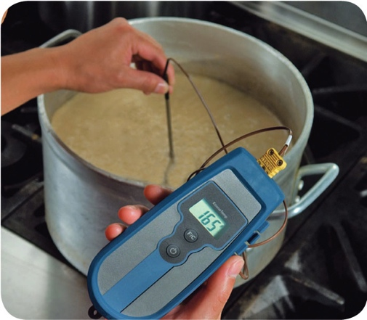
Reheating Food
Food reheated for immediate service:
Can be reheated to any temperature if it was cooked and cooled correctly.
Food reheated for hot-holding:
Must be reheated within two hours to an internal temperature of 165˚F (74˚C) for 15 seconds.
Reheat commercially processed and packaged ready-to-eat food to an internal temperature of at least 135˚F (57˚C).
8-46
Notes:
Instructor Notes
These guidelines apply to all heating methods, such as ovens or microwave ovens.

