Slide 2
Objectives
Identify the following:
  Characteristics of an approved supplier
  Guidelines for receiving and inspecting deliveries
  Requirements for key drop deliveries
  Procedure for handling food recalls
  Procedures for checking the temperatures of various food items
  Temperature requirements when receiving food
6-2

Slide 3
Objectives
Identify the following:
  Packaging requirements when receiving food
  Documentation required when receiving food
  Government inspection stamps required when receiving food
  Quality requirements when receiving food
  Receiving criteria for specific food items
6-3

Slide 4

Purchasing Considerations
Purchase food from approved, reputable suppliers:
  They have been inspected
  They meet all applicable local, state, and federal laws
6-4
Notes:
Instructor Notes
Food must be purchased from approved, reputable suppliers. These suppliers have been inspected and can show you an inspection report. They also meet all applicable local, state, and federal laws.
These standards apply to all suppliers in the supply chain. Your operation’s chain can include growers, shippers, packers, manufacturers, distributors (trucking fleets and warehouses), and local markets.
Develop a relationship with your suppliers, and get to know their food safety practices.

Slide 5
Purchasing Considerations
A supplier’s inspection report should review these areas:
  Receiving and storage
  Processing
  Shipping
  Cleaning and sanitizing
  Personal hygiene
  Staff training
  Recall program
  HACCP program or other food safety system
6-5
Notes:
Instructor Notes
Consider reviewing suppliers’ most recent inspection reports. These reports can be from the U.S. Department of Agriculture (USDA), the Food and Drug Administration (FDA), or a third-party inspector. They should be based on Good Manufacturing Practices (GMP) or Good Agricultural Practices (GAP).
GMPs are the FDA’s minimum sanitation and processing requirements for producing safe food. They describe the methods, equipment, facilities, and controls used to process food.
Both suppliers and their sources are subject to GMP inspections.

Slide 6
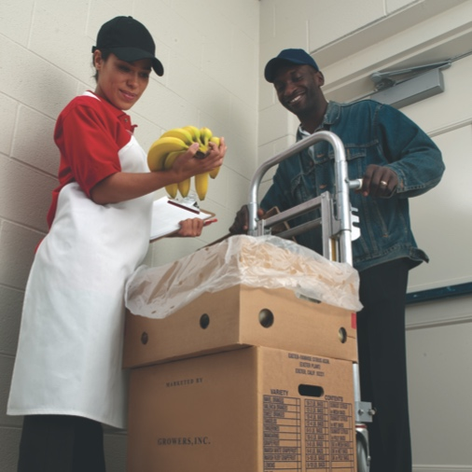
Receiving Considerations
  Receiving guidelines:
  Have food delivered when staff can inspect it.
  Make specific staff responsible for receiving.
    Train them to follow food safety procedures.
    Allow them to accept, reject, and sign for deliveries.
    Provide staff with tools.
  Plan ahead for shipments.
  Inspect deliveries immediately.
6-6
Notes:
Instructor Notes
Suppliers should deliver food when staff have enough time to inspect it. Schedule deliveries at a time when they can be received correctly.
Make specific staff responsible for receiving. Train them to follow food safety procedures, including checking items for correct temperatures, expired code dates, signs of thawing and refreezing, and pest damage.
Provide staff with the tools they need, including purchase orders, thermometers, and scales. Then make sure enough trained staff are available to receive and inspect food items promptly.
Plan ahead for deliveries. Have clean hand trucks, carts, dollies, and containers ready. Also make sure there is enough space in dry-storage and walk-in areas for deliveries.

Slide 7
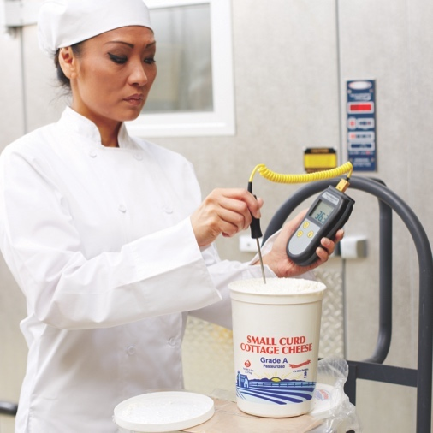
Receiving Considerations
Inspection process:
  Inspect the delivery truck.
  Inspect the food items.
    Count quantities and spot-check weights.
    Check for damage, repackaging, and mishandling.
    Take sample temperatures of all TCS food.
  Inspect and store each delivery before accepting another one.
6-7
Notes:
Instructor Notes
The process starts with a visual inspection of the delivery truck. Check it for signs of contamination. Inspect the overall condition of the vehicle. Look for signs of pests. If there are signs of problems, reject the delivery.
Continue with a visual inspection of food items. Look at each delivery right away to count quantities, check for damaged food, and look for items that might have been repacked or mishandled. Spot-check weights and take sample temperatures of all TCS food, as shown in the photo.
Inspect and store each delivery before accepting another one. This will prevent temperature abuse in the receiving area.

Slide 8
Receiving Considerations
Key drop deliveries:
  Supplier is given after-hour access to the operation
  to make deliveries.
  Staff must inspect the deliveries upon arrival at the operation.
  Deliveries must meet the following criteria.
    From an approved source
    Placed in the correct storage location to
    maintain the required temperature
    Protected from contamination in storage
    NOT contaminated
    Presented honestly
6-8
Notes:
Instructor Notes
Some restaurant and foodservice operations receive food after-hours when they are closed for business. This is often referred to as a key drop delivery.
The supplier is given a key or other access to the operation to make the delivery. Products are then placed in coolers, freezers, and dry storage areas. The delivery must be inspected once you arrive at the operation and meet the criteria identified in the slide.

Slide 9
Receiving Considerations
Rejecting items:
  Separate rejected items from accepted items.
  Tell the delivery person what is wrong with the item.
  Get a signed adjustment or credit slip before giving
  the rejected item to the delivery person.
  Log the incident on the invoice or receiving document.
6-9
Notes:
Instructor Notes
Occasionally, you may be able to recondition and use items that would have been rejected. For example, a shipment of cans with contaminated surfaces may be cleaned and sanitized, allowing them to be used. However the same cans may not be reconditioned if the contamination was a result of damage to the cans.

Slide 10
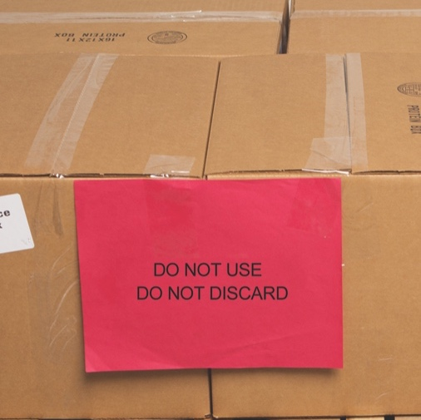
Receiving and Inspecting
Recalls:
  Identify the recalled food items.
  Remove the item from inventory.
  Store the item separately.
  Label the item to prevent it from being placed back in inventory.
  Inform staff not to use the product.
  Refer to the vendor’s notification or recall notice for what to do with the item.
6-10
Notes:
Instructor Notes
Food items you have received may sometimes be recalled by the manufacturer. This may happen when food contamination is confirmed or suspected. It can also occur when items have been mislabeled or misbranded. Often food is recalled when food allergens have not been identified on the label. Most vendors will notify you of the recall. However you should also monitor recall notifications made by the FDA and the USDA. Follow the guidelines in the slide when notified of a recall.
Identify the recalled food items by matching information from the recall notice to the item. This may include the manufacturer’s ID, the time the item was manufactured, and the item’s use-by date.
Remove the item from inventory, and place it in a secure and appropriate location. That may be a cooler or dry-storage area.
Store the recalled item separately from food, utensils, equipment, linens, and single-use items.
Label the item in a way that will prevent it from being placed back in inventory. Some operations do this by including a “Do Not Use” and “Do Not Discard” label on recalled food items. Inform staff not to use the product.
Refer to the vendor’s notification or recall notice for what to do with the item. For example, you might be instructed to throw it out or return it to the vendor.

Slide 11
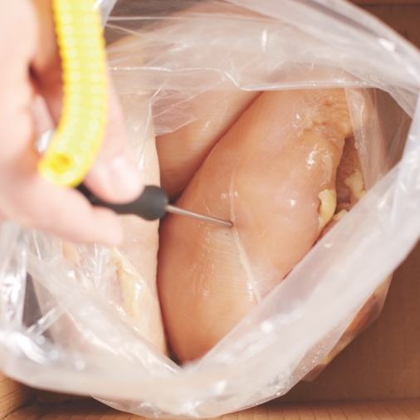
Checking Temperatures
  Checking the temperature of meat, poultry,
  and fish:
  Insert the thermometer stem or probe into the thickest part of the food (usually the center).
6-11

Slide 12
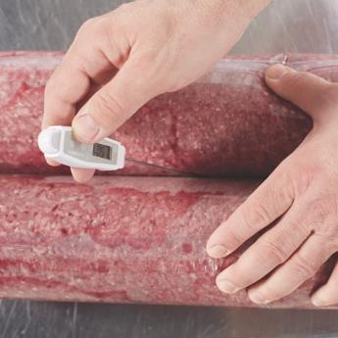
Checking Temperatures
Checking the temperature of ROP Food
(MAP, vacuum-packed, and sous vide food):
  Insert the thermometer stem or probe between
  two packages.
  As an alternative, fold packaging around the thermometer stem or probe.
6-12
Notes:
Instructor Notes
ROP stands for reduced-oxygen packaging. It includes modified atmosphere packaging (MAP), vacuum-packed, and sous vide food.
It may be possible to check the temperature of bulk food by folding the packaging around the thermometer stem or probe. Be careful not to puncture the packaging when using this method.

Slide 13
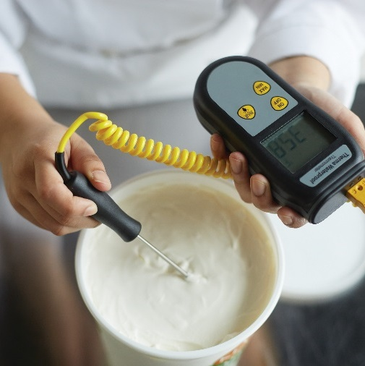
Checking Temperatures
  Checking the temperature of other packaged food:
  Open the package and insert the thermometer stem or probe into the food.
6-13
Notes:
Instructor Notes
When checking the temperature of food by this method, make sure the sensing area of the thermometer stem or probe is fully immersed in the food. The stem or probe must not touch the package.

Slide 14
Temperature Requirements
Temperature criteria for deliveries:
  Cold TCS food: Receive at 41˚F (5˚C) or lower, unless otherwise specified.
  Live shellfish (oysters, mussels, clams, and scallops ): Receive at an air temperature of 45˚F (7˚C) and an internal temperature no greater than
  50˚F (10˚C).
    Once received, the shellfish must be cooled to 41˚F (5˚C) or lower in four hours.
  Shucked shellfish: Receive at 45˚F (7˚C)
  or lower.
    Cool the shellfish to 41˚F (5˚F) or lower in
    four hours.
6-14

Slide 15

Temperature Requirements
Temperature criteria for deliveries:
  Milk: Receive at 45˚F (7˚C) or lower.
    Cool the milk to 41˚F (5˚C) or lower in four hours.
  Shell eggs: Receive at an air temperature of 45˚F (7˚C) or lower.
  Hot TCS food: Receive at 135˚F (57˚C) or higher.
6-15

Slide 16
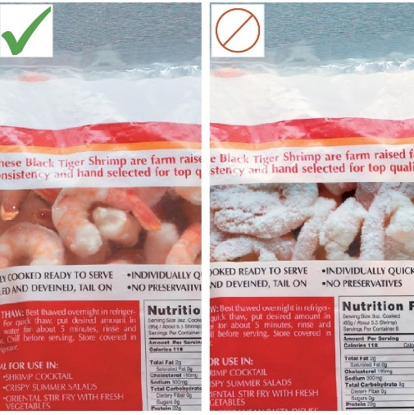
Temperature Requirements
Temperature criteria for deliveries:
  Frozen food: Receive frozen solid.
  Reject frozen food if there is evidence of thawing and refreezing.
    Fluids or water stains in case bottoms or
    on packaging
    Ice crystals or frozen liquids on the food
    or packaging
6-16
Notes:
Instructor Notes
Thawing and refreezing shows that the food was time-temperature abused.

Slide 17
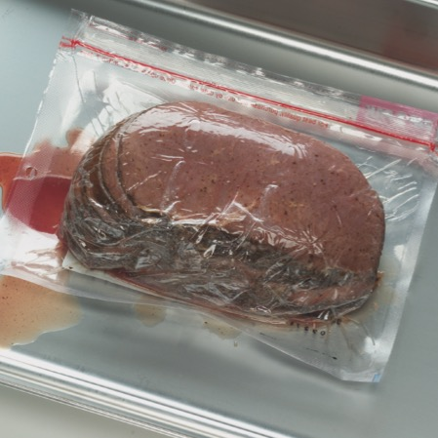
Packaging
Reject packaged items with:
  Tears, holes, or punctures in packaging
  Cans—Severe dents in the seam or body, missing labels, swollen or bulging ends, holes, leaks, rust
  ROP food—Bloating or leaking
  Broken cartons or seals
6-17
Notes:
Instructor Notes
Both food items and nonfood items such as single-use cups, utensils, and napkins, must be packaged correctly when you receive them. Items should be delivered in their original packaging with a manufacturer’s label. The packaging should be intact, clean, and protect food and food-contact surfaces from contamination.
Reject food and nonfood items if packaging has any of the problems listed on the slide.

Slide 18
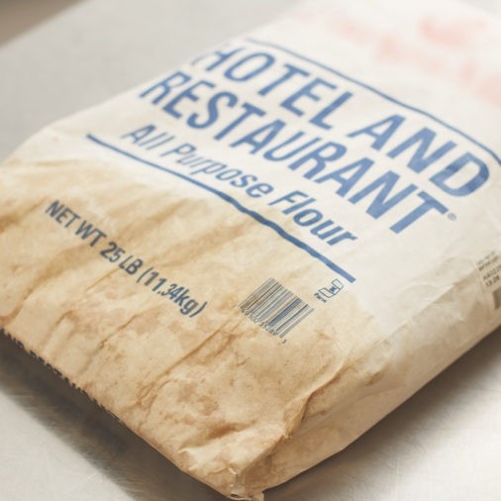
Packaging
Reject packaged items with:
  Dirty and discolored packaging
  Leaks, dampness, or water stains
  Signs of pests or pest damage
  Signs of tampering
  Missing or incorrect labels
  Expired use-by/expiration dates
6-18
Notes:
Instructor Notes
Food items must be correctly labeled.
Do NOT accept food that is missing a use-by date or expiration date from the manufacturer. This date is the recommended last date for the product to be at peak quality.
Some operations label food items with the date the item was received to help with stock rotation during storage.
You may see other dates on labels. A sell-by date tells the store how long to display the product for sale. A best-by date is the date by which the product should be eaten for best flavor or quality.

Slide 19
Documents and Stamps
Required documents:
  Shellfish must be received with shellstock identification tags.
    Tags indicate when and where the shellfish were harvested.
  Store shellfish in their original container.
    Do NOT remove the shellstock tag until the last shellfish is used.
    Write the date the last shellfish was used on the shellstock tag.
    Keep the shellstock tag on file for 90 days after the last shellfish was used.
6-19
Notes:
Instructor Notes
Store shellfish in their original container. Do NOT remove the shellstock tag from the container until the last shellfish has been used.
When the last shellfish is removed from the container, write the date on the shellstock tag. Then keep the tag on file for 90 days from that date.

Slide 20
Documents and Stamps
Required documents:
  Fish that will be eaten raw or partially cooked
    Documentation must show the fish was correctly frozen before being received
    Keep documents for 90 days from the sale of the fish
  Farm raised fish
    Must have documentation stating the fish was raised to FDA standards
    Keep documents for 90 days from the sale of the fish
6-20

Slide 21

Documents and Stamps
Products requiring inspection stamps:
  Meat and poultry
    Carcass or packaging must have a USDA or state department of agriculture stamp.
    Stamp indicates product and processing plant have met certain standards.
  Egg products
    Liquid, frozen, and dehydrated eggs must also have a USDA inspection mark.
    Grading stamps:
  Voluntary
  Paid for by processors and packers
6-21
Notes:
Instructor Notes
Meat must be purchased from plants inspected by the USDA or a state department of agriculture. Note that “inspected” does not mean that the product is free of pathogens; rather, it means that the product and the processing plant have met defined standards.
Carcasses and packages of meat that have been inspected will have an inspection stamp with abbreviations for “inspected and passed” by the inspecting agency, along with a number identifying the processing plant. An example of this stamp appears in top right on the slides.
Poultry is inspected by the USDA or the state department of agriculture in much the same way as meat. An example of a poultry inspection stamp is shown in the bottom right on the slide.
Liquid, frozen, and dehydrated eggs must also have a USDA inspection mark. These types of eggs are required by law to be pasteurized.
Note that grading stamps might also appear on packages of eggs, meat, and poultry. Grading of these types of products is voluntary and paid for by processors and packers.

Slide 22
Food Quality
Assessing food quality:
  Appearance: Reject food that is moldy or has an abnormal color.
  Texture: Reject meat, fish, or poultry if
    It is slimy, sticky, or dry
    It has soft flesh that leaves an imprint when touched
  Odor: Reject food with an abnormal or unpleasant odor.
6-22
Notes:
Instructor Notes
Poor food quality can be a sign that the food has been time-temperature abused and, therefore, may be unsafe.
Work with your suppliers to define specific safety and quality criteria for the food items you typically receive. Reject food if it has any of the problems shown on the slide.
Reject food that is moldy or has an abnormal color. Food that is moist when it should be dry, such as salami, should also be rejected. Do not accept any food item that shows signs of pests or pest damage. Reject frozen food that has large ice crystals on it. This may be evidence of thawing and refreezing.
In addition to the guidelines above, you should always reject any item that does not meet your company’s standards for quality.

Slide 23
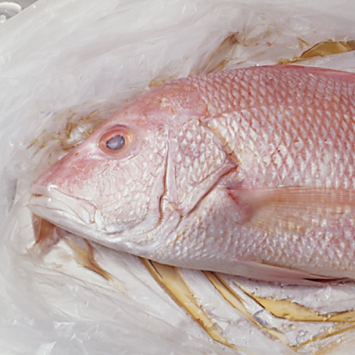
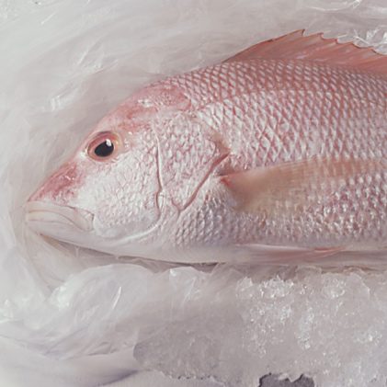
Inspecting Specific Types of Food
Fresh fish:
Accept criteria:
  Bright red gills; bright shiny skin
  Firm flesh that springs back when touched
  Mild ocean or seaweed smell
  Bright, clear, full eyes
  Product surrounded by crushed, self-draining ice
Reject criteria:
  Dull gray gills; dull dry skin
  Soft flesh that leaves an imprint when touched
  Strong fishy or ammonia smell
  Cloudy, red-rimmed, sunken eyes
  Tumors, abscesses, or cysts on the skin
6-23

Slide 24
Inspecting Specific Types of Food
Shellfish:
Accept criteria:
  Mild ocean or seaweed smell
  Shells are closed and unbroken, indicating that the shellfish are alive
  If fresh, they must be received alive
Reject criteria:
  Slimy, sticky, or dry
  Strong fishy smell
  Shells are excessively muddy or broken
  Dead on arrival (open shells that do not close when tapped)
6-24

Slide 25
Inspecting Specific Types of Food
Crustaceans:
Accept criteria:
  Mild ocean or seaweed smell
  Shipped alive, packed in seaweed, and kept moist
Reject criteria:
  Strong fishy smell
  Dead on arrival
6-25

Slide 26
Inspecting Specific Types of Food
Meat:
Accept criteria—color:
  Beef: bright cherry red; aged beef may be darker; vacuum-packed beef will appear purplish
  Lamb: light red
  Pork: light pink meat; firm, white fat
Reject criteria—color:
  Beef: brown or green
  Lamb: brown, whitish surface covering the lean meat
  Pork: excessively dark color; soft or rancid fat
6-26

Slide 27
Inspecting Specific Types of Food
Meat:
Accept—other criteria:
  Firm flesh that springs back when touched
  No odor
  Packaging is intact and clean
Reject—other criteria:
  Slimy, sticky, or dry
  Sour odor
  Broken cartons; dirty wrappers; torn packaging; broken seals
6-27

Slide 28
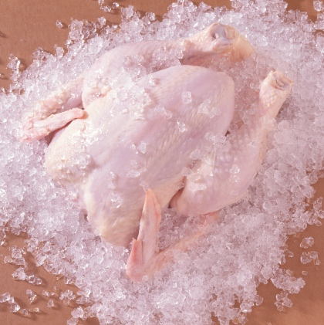
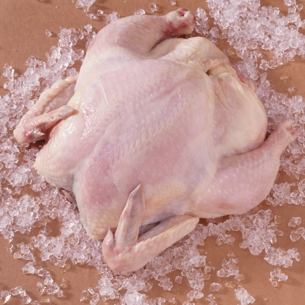
Inspecting Specific Types of Food
Poultry:
Accept criteria:
  No discoloration
  Firm flesh that springs back when touched
  No odor
  Should be surrounded by crushed, self-draining ice
Reject criteria:
  Purple or green discoloration around the neck; dark wing tips (red are acceptable)
  Stickiness under the wings and around joints
  Abnormal, unpleasant odor
6-28

Slide 29

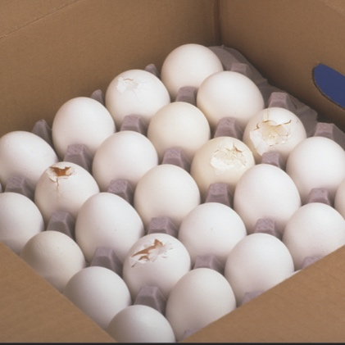
Inspecting Specific Types of Food
Eggs:
Accept criteria:
  No odor
  Clean and unbroken shells
Reject criteria:
  Sulfur smell or off odor
  Dirty or cracked shells
6-29

Slide 30
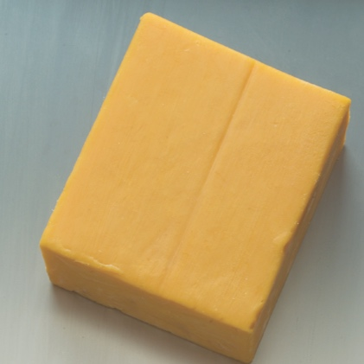
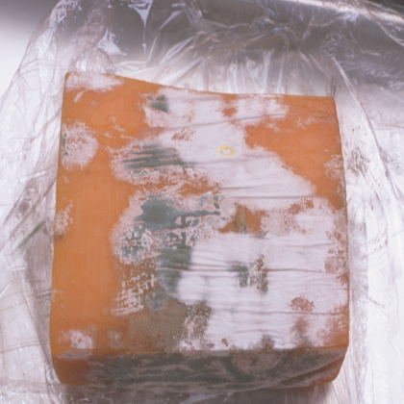
Inspecting Specific Types of Food
Dairy products:
Accept criteria:
  Milk: Sweetish flavor
  Butter: Sweet flavor; uniform color; firm texture
  Cheese: Typical flavor and texture; uniform color; clean and unbroken rind
Reject criteria:
  Milk: Sour, bitter, or moldy taste; off odor; expired sell-by date
  Butter: Sour, bitter, or moldy taste; uneven color; soft texture; contains foreign matter
  Cheese: Abnormal flavor or texture; uneven color; unnatural mold; unclean or broken rind
6-30

Slide 31

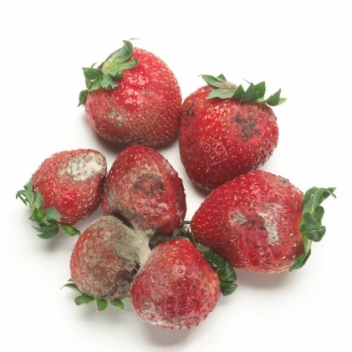
Inspecting Specific Types of Food
Fresh produce:
Accept criteria:
  Temperature varies according to the product
  Condition varies according to the product
Reject criteria:
  Evidence of mishandling or insects (including insect eggs and egg cases)
  Mold, cuts, wilting, unpleasant odors, discoloration, etc. (will depend on the produce involved)
6-31

